Slide 1
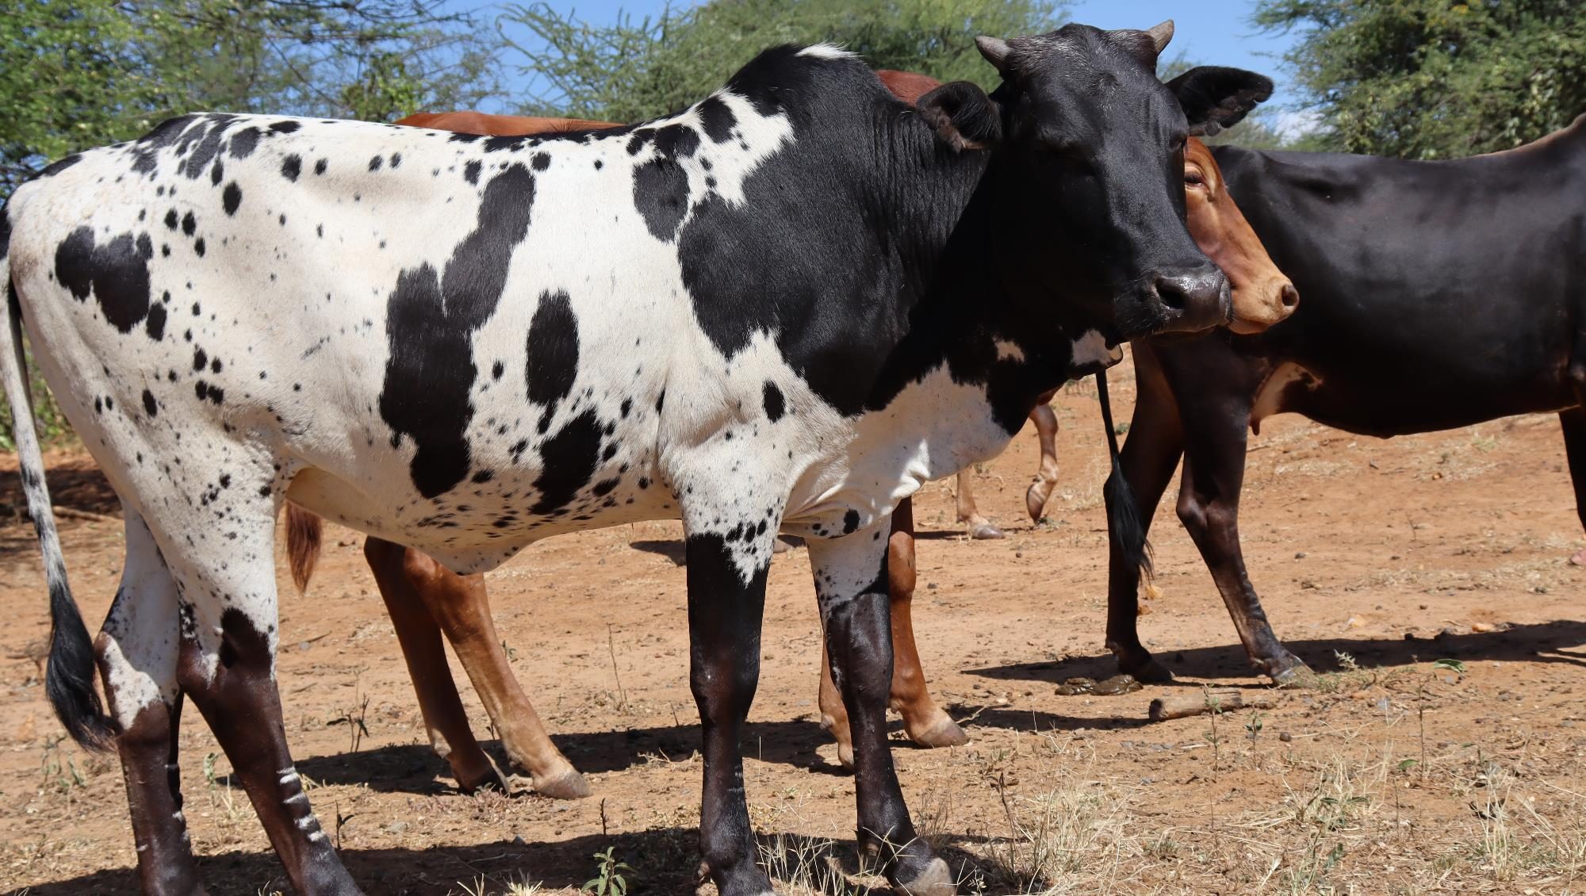
Livestock monitoring tools:
Animal Feed Balances, PLEWS and PET
Dr. Paul Opio
Livestock and Pastoralism Adviser Resilience Team For Eastern Africa

Slide 2
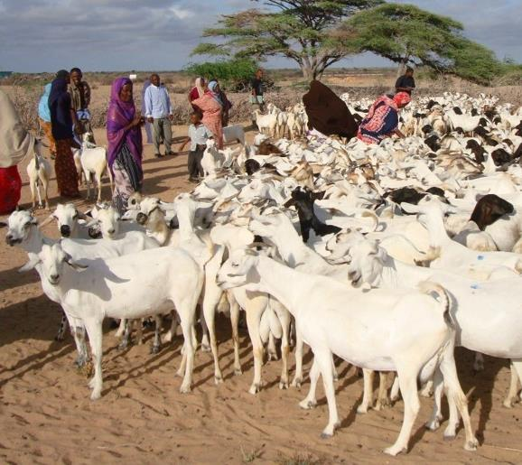
Context
East Africa has a population of over 200 million people with diverse and rich culture, resources and opportunities while livestock population is estimated at 640 million heads
The livestock sector provides between 30 and 80 percent of the agricultural GDP, generates up to 70 percent of household cash income
The sector also forms the basis for agriculture-led growth and the socio-economic transformation, envisioned in AU’s Malabo Declaration “Accelerated Africa Agriculture Growth and Transformation for shared prosperity and improved livelihoods” and the declaration that forms the AU Agenda 2063 framework

Slide 3
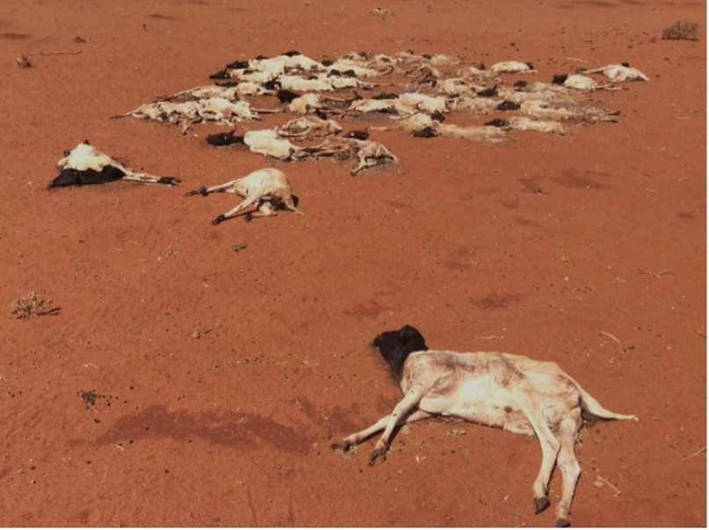
Context
Recurrent Droughts: keeps population on the move, loss of livestock, separation of families, migration, ecosystem disintegration, and community conflicts and survival of the pastoral system at stake
Feed crisis: Kenya’s economy lost about USD 3.3 billion due to the effects of drought on livestock from 2008 to 2011; Somalia economic loss estimated USD 1.5 billion ( Update 2017)
Despite important investments in pastoral areas spanning over decades, access to livestock feed still remains elusive in the region
Pastoral poverty: in the HoA is mainly driven by feed and water scarcity. Alleviating poverty in pastoral areas necessitates addressing this fundamental gap
Lack of feed (reserve) and water: mass livestock mortality, morbidity, and reduction in the overall livestock productivity

Slide 4
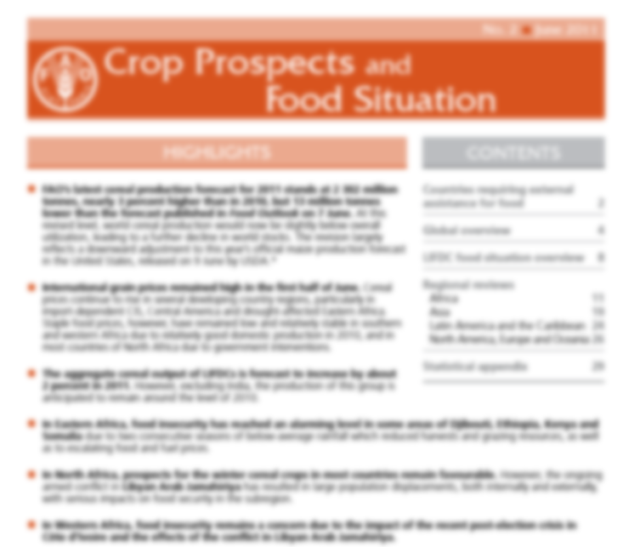
Livestock feed information and reporting – Decision Making?
The outlook for the 2011 harvests and livestock conditions raises serious food security concerns following poor and erratic rainfall from March to May. The current lack of adequate pastures has led to a worsening of livestock body conditions and even some deaths. This has consequently reduced good market prospects, directly impacting pastoralists’ incomes and their access to staple food. Across eastern Africa, cereal prices continued their upward trend that started in September-October 2010.

Slide 5
Livestock feed information and reporting – Decision Making?
Livestock body condition for most cattle and sheep was fair to poor while that of goats and camel was fair across counties. The current livestock body condition has slightly declined compared to last month due to the increase in trekking distances in search of pasture and water coupled with reduction in pasture and browse availability. Overall, the delayed onset of March to May long rains and the poor rainfall performance aggravated shortage of water and pasture and also had an adverse effect on farming activities across the ASAL region. Table 4 shows the trend in milk production in the 23 ASAL counties. Milk production in most ASAL counties is currently below the long term average which is attributed to poor availability of water, pasture and browse. In Tana River, for example, average milk produced per household per day is 48 percent below the LTA for the month. In the same way average milk production in Lamu, Mandera, Garissa, Samburu, Kajiado and Narok was below LTA by 69, 47, 44, 42, 39 and 38 percent respectively.

Slide 6
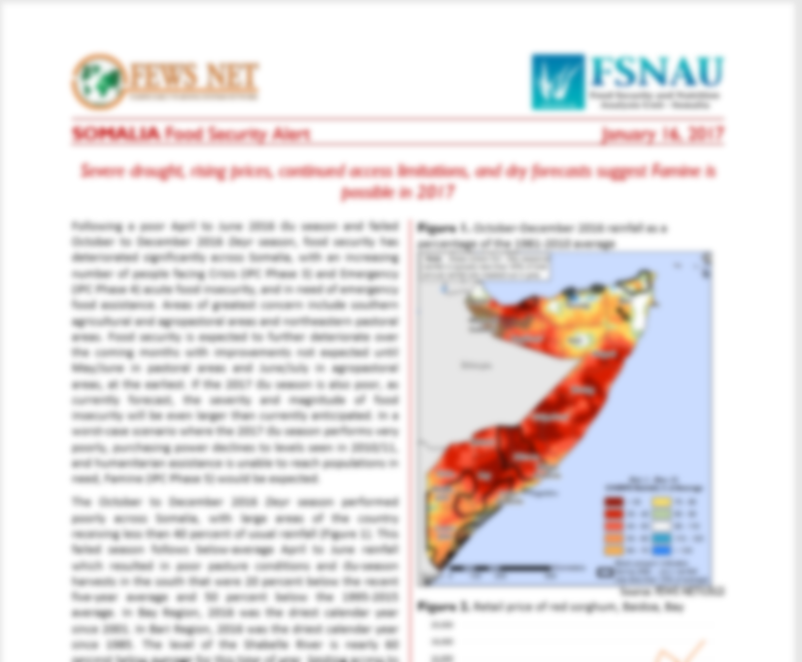
Livestock feed information and reporting – Decision Making?
This failed season follows below-average April to June rainfall which resulted in poor pasture conditions and Gu-season harvests in the south that were 20 percent below the recent five-year average and 50 percent below the 1995-2015 average. In pastoral livelihood zones, pasture and water resources are very limited, especially in central and northeastern area`s. This is leading to atypical livestock migration and livestock deaths

Slide 7
Why?
CROPPING
LIVESTOCK
According to FAO’s Agricultural Stress Index (ASI), severe drought is currently affecting between 55 and 85 percent of the cropland. In the “sorghum belt” of Bay Region and eastern areas of neighbouring Gedo and Middle Juba regions, rains started in the third dekad of April with a delay of more than two weeks and cumulative seasonal precipitations have been so far 40-60 percent below average. Here, drought is now affecting 25-85 percent of the cropland in most areas. As of late April, proper germination was reported to have occurred only in less than one-third of the area planted to cereals. Precipitations in April and early May are crucial for the performance of the “Gu” crops as, in southern Somalia, they account for more than 50 percent of the cumulative seasonal rains. The heavy rains received in mid-May and rainfall forecasts, point to near-average to average precipitations for the remainder of the season are, therefore, not expected to significantly improve crop prospects. According to the FAO Food Security and Nutrition Analysis Unit (FSNAU) - Somalia and FEWS NET, the aggregate “Gu” output is forecast to be 40‑50 percent below average. It would be the second consecutive poor harvest as the 2018/19 “Deyr” harvest, gathered last January, was more than 20 percent below average due to inadequate precipitations.
Livestock body condition for most cattle and sheep was fair to poor while that of goats and camel was fair across counties. The current livestock body condition has slightly declined compared to last month due to the increase in trekking distances in search of pasture and water coupled with reduction in pasture and browse availability. Overall, the delayed onset of March to May long rains and the poor rainfall performance aggravated shortage of water and pasture and also had an adverse effect on farming activities across the ASAL region. Table 4 shows the trend in milk production in the 23 ASAL counties. Milk production in most ASAL counties is currently below the long term average which is attributed to poor availability of water, pasture and browse. In Tana River, for example, average milk produced per household per day is 48 percent below the LTA for the month. In the same way average milk production in Lamu, Mandera, Garissa, Samburu, Kajiado and Narok was below LTA by 69, 47, 44, 42, 39 and 38 percent respectively.

Slide 8
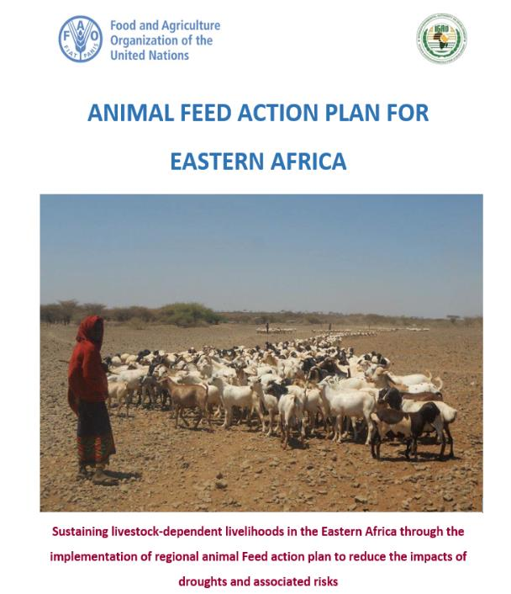
East Africa animal feed action plan
Priority Area 1. Establishing animal feed information, early warning and response system [short-term]
Priority Area 2. Developing sustainable animal feed and forage supply chains [short-medium term]
Priority Area 3. Improving rangelands and grazing areas use and governance [Long-term]
Priority Area 4. Strengthening enabling environment on feed and forage production [short-medium term]
Notes:
Inclusive consultative process - FAO Headquarters, Rome, on 20-21 June 2017.
September 2017, technical consultation - Horn of Africa (HoA) Naivasha Kenya- USAID.
End of 2017, three technical workshops were held in Kenya, Ethiopia and Somalia.
FAO-sponsored assessments on support to Institutionalization of Livestock Feed Security System in Ethiopia and Kenya -Regional Livestock Feeding Action Plan drafted between April and May 2018 – endorsed by member states and partners

Slide 9
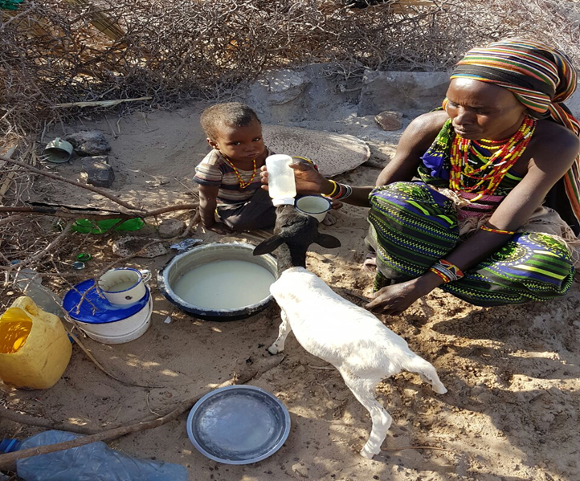
livestock early warning tools - P1 of AFAP
“ If you can’t measure it, you can’t manage it.”
Peter Drucker
Animal Feed Inventory and Balance – IGAD (ICPALD)
Predictive Livestock Early Warning System (PLEWS) – Texas A&M University
Pictorial Evaluation Tool – PET Livestock – AgritechTalk Africa
CIRAD and other partners -West Africa and Sahel

Slide 10
Feed Inventory And Feed Balance
P1 of AFAP for Eastern Africa
National Feed Inventory: what feed resources, how much and where
National Feed Balance : a balance between the supplies and demands for livestock feeds in a country
Characterization of feeding systems : how currently feed resources are being used in a region within a country.

Slide 11
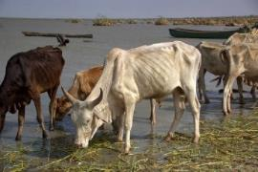
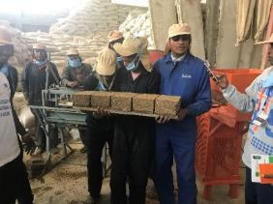
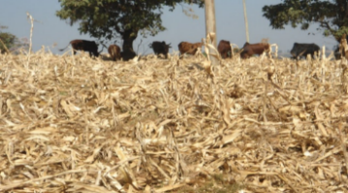
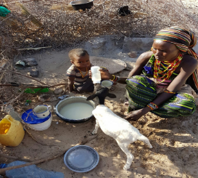
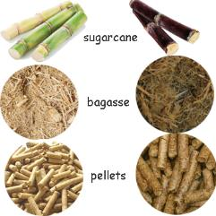
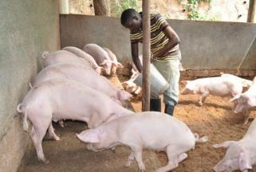
Feed Inventory And Feed Balance
A comparison between the requirements of livestock (demand) and amount of utilizable feed (supply)
Demand
Supply
Animal
Feed

Slide 12
National Feed Inventory and Feed Balance Systemiol Feed Inventory and Feed Balance
CROP DATA
LULC DATA
ANIMAL DATA
MODEL
Crop resources
LU resources
Animal resources
Cereals
Oilseeds
Pulses
Permanent crops
Forest
Grazing
Wetland
Cattle, Sheep
Goat, Camel
Donkey
Mule
DM, ME, CP AVAILABILITY
TLU DM, ME, CP REQUIREMENT
LULC: Land Use and Land Cover
FEED BALANCE ON DM, ME, CP Basis
Feed Availability
Feed Requirement

Slide 13
Feed Inventory Categories - availability
Roughages Cereal straws Pulse aerial parts Oilseed straw/aerial part Legume husk Horticulture crops plant aerial parts and by-products Stubble feeding (aftermath) Root aerial parts Industrial crop by products Concentrates Pulse brans Cereal brans Oil seed cakes Roots of root crops Acacia and prosopis pods | Cultivated fodder Agro-industrial by-products Grains, beans, meals for monogastric animals Rangeland pastures Predictive Livestock Early Warning System (PLEWS) (Remote sensing/Satellite Imaging)

Slide 14
An example: Availability of Crop Residues (10³ tonnes/year)
Oromia > Amhara > SNPPR > Tigray
Region | Cereal straws/stovers | Pulse straws | Oil seed straws | Vegetable plant aerial parts | Root crop aerial parts | Total Residues in respective regions (x10³ tonnes)/year
Tigray | 2854.327 | 60.248 | 157.3884 | 3.823 | 2.80 | 3078.586
Afar | 89.06 | 0.60 | 0 | 0 | 0 | 89.66
Amhara | 12259.68 | 1233.84 | 587.47 | 46.59 | 201.54 | 14329.12
Oromia | 19486.89 | 1412.79 | 731.62 | 99.81 | 498.921 | 22230.03
Somale | 276.11 | 1.12 | 7.71 | 0.33 | 3.32 | 288.59
Benshangul-Gumuz | 743.8274 | 18.29 | 162.45 | 2.29 | 4.75 | 931.607
SNPPR | 4055.615 | 569.32 | 26.369 | 199.2155 | 945.76 | 5796.28
Gambela | 43.67 | 0.122 | 0.47 | 0.046 | 0 | 44.308
Harari | 34.37 | 0.0136 | 5.22 | 0.23 | 0 | 39.834

Slide 15
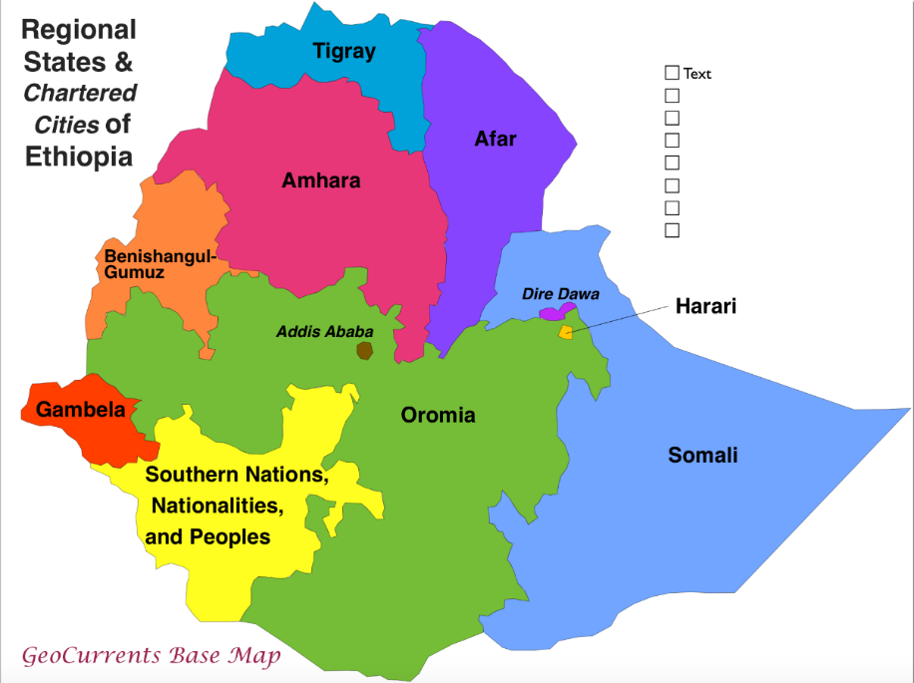
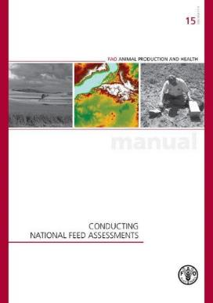
Biomass Availability - Ethiopia
Regional states and Chartered cities of Ethiopia
Crop residue / brans
Sugarcane tops
Sugarcane bagasse
Grass hay
Oilseed cakes
Pulse by-products
Browses/bushes

Slide 16
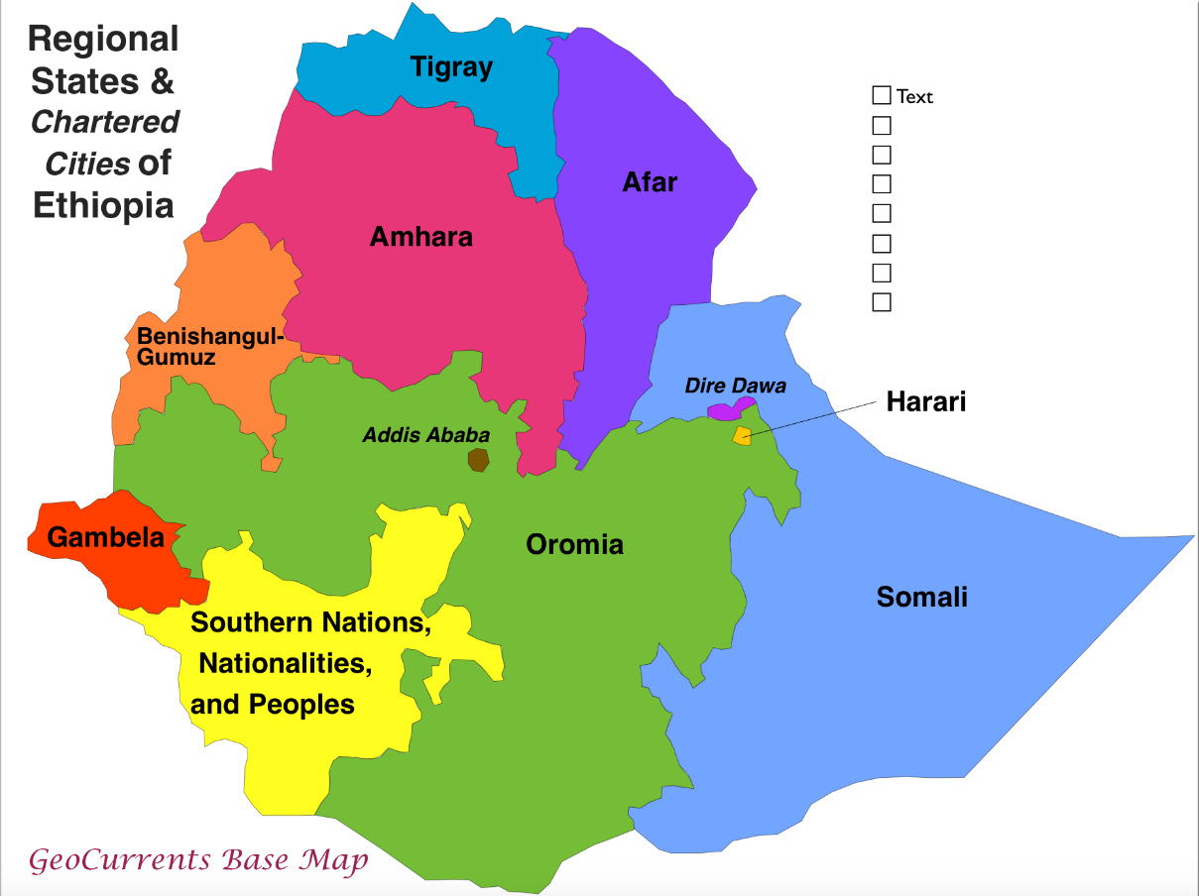
Grass, Sugarcane tops and Bargasse Availability - Ethiopia
Regional states and Chartered cities of Ethiopia
Sugarcane tops
Sugarcane bagasse
(373000 tonnes)
Grass hay (4.7 million tonne)
- Densified block manufacturing units and/or
- Hay/crop residue densification
Fodder/feed bank
If 50% of + can be utilized
Cover feed requirement, @ 2.5%
BW, of 4.44 million cattle or
44.4 million shots for 90 days

Slide 17
Feed Requirements - Demand
DM
Factors used for converting livestock number to Tropical Livestock Units (TLU; 250 kg = 1 TLU)
Cattle 0.7
Sheep 0.1
Goat 0.1
Camel 1
Donkey 0.5
Mule 0.7
Horse 0.9
Dry matter intake per TLU was estimated as 2.5% of the body weigh i.e. 6.25 kg/day.
Metabolizable Energy
ICAR/NRC/AFRC/IPCC
Protein
ICAR/NRC/AFRC

Slide 18
Balance based on Actual Availability of Feed Resources (taking into account competitive uses)
Region | Feed dry matter balance (%) | Feed metabolizable energy balance (%) | Feed crude protein balance (%)
Tigray | -21.07 | -53.06 | -51.87
Afar | -35.14 | -51.30 | -48.10
Amhara | -16.88 | -50.68 | -47.04
Oromia | -24.03 | -53.93 | -50.87
Somali | +29.39 | -5.02 | +0.57
B-G | +142.98 | +47.16 | +73.37
SNNPR | -40.31 | -62.62 | -57.89
Gambela | +280.36 | +139.05 | +163.52
Harari | -70.98 | -81.28 | -84.09
Dire Dawa | -55.53 | -69.34 | -74.49
Total | -21.16 | -51.70 | -48.24

Slide 19
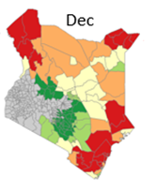
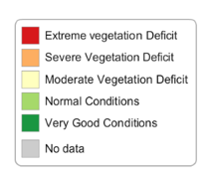
PREDICTIVE LIVESTOCK EARLY WARNING INFORMATION (PLEWS) – TEXAS A&M UNIVERSITY
A decision support tool that can project edible vegetation up to six months into the future
Initiated in response to NDMA’s request - indicator for drought response and contingency planning
Innovative in two key ways:
Enables the projection of future forage conditions, rather than just current conditions, and
Unlike NDVI, PLEWS excludes inedible species and considers specific feeding preferences of different livestock species

Slide 20
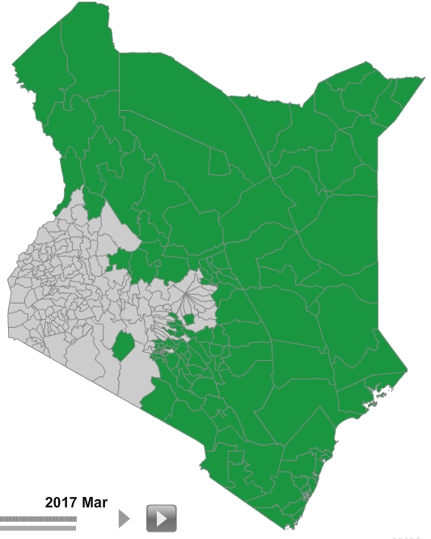
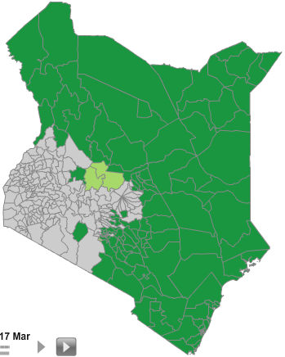
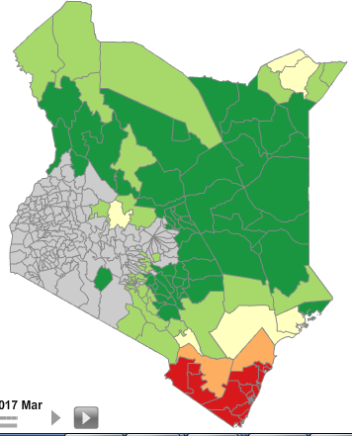
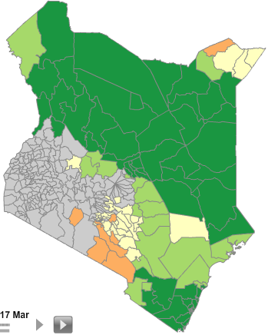
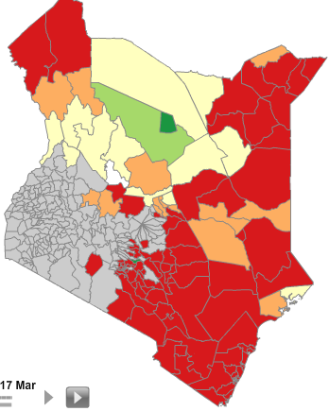
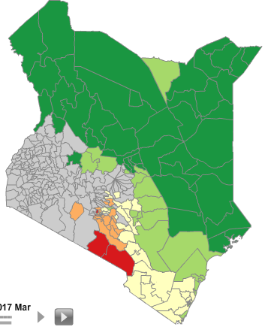
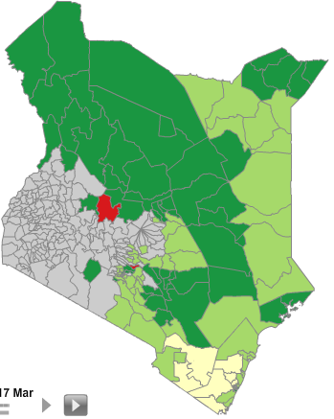
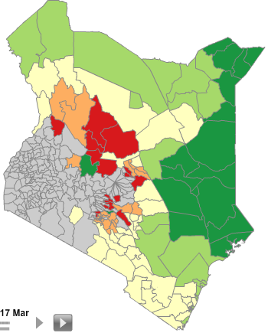
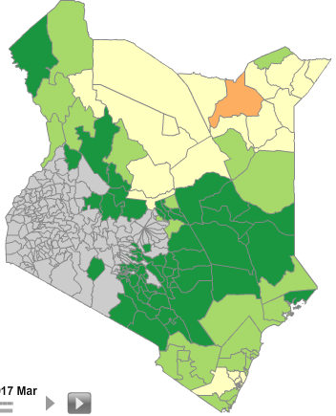
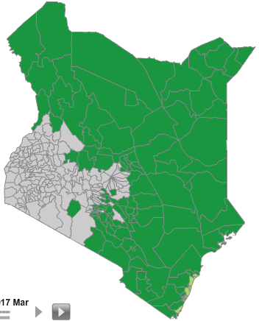
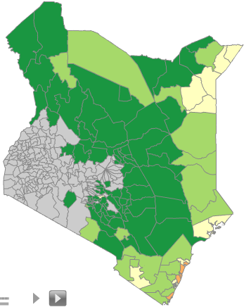
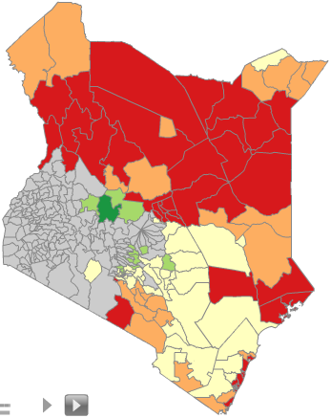
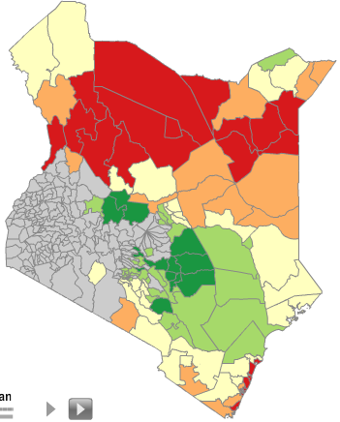
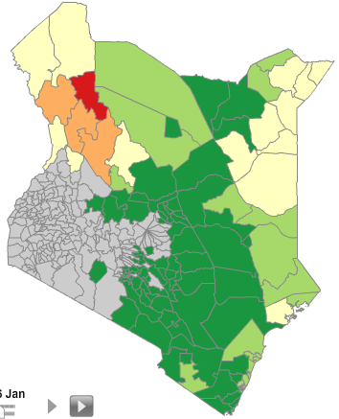
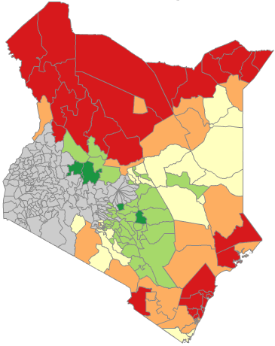
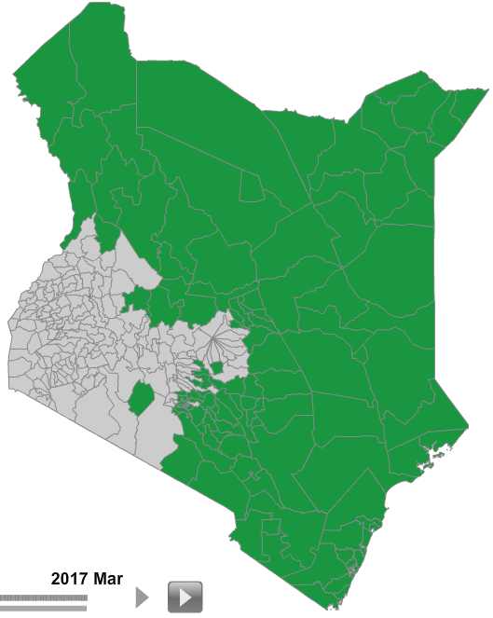
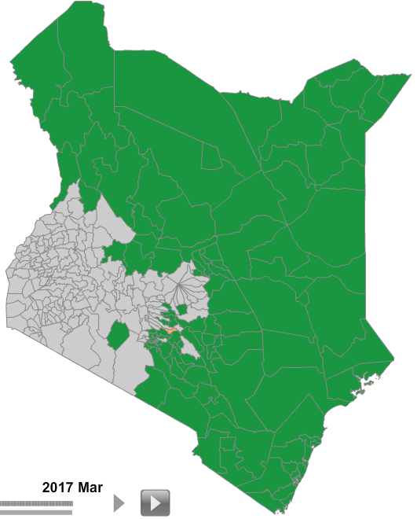
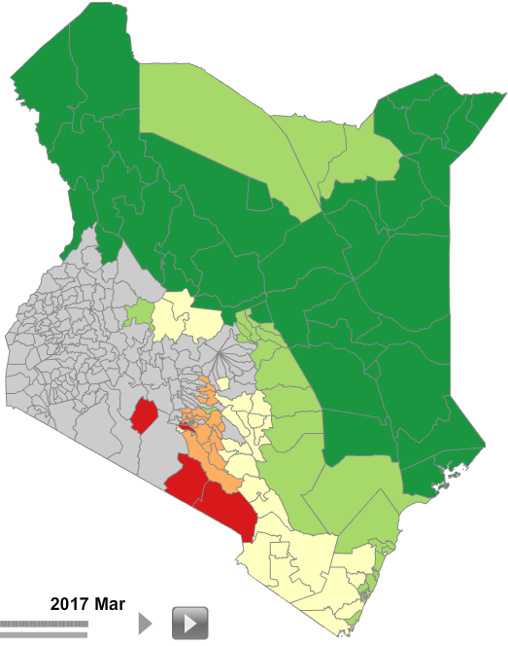
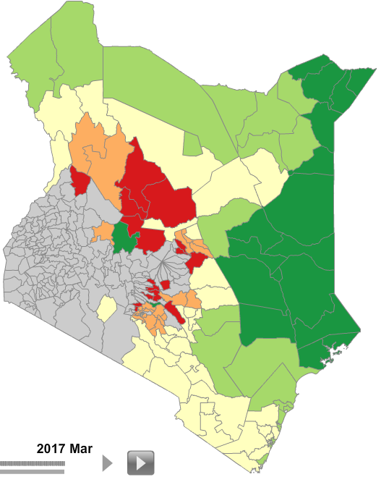
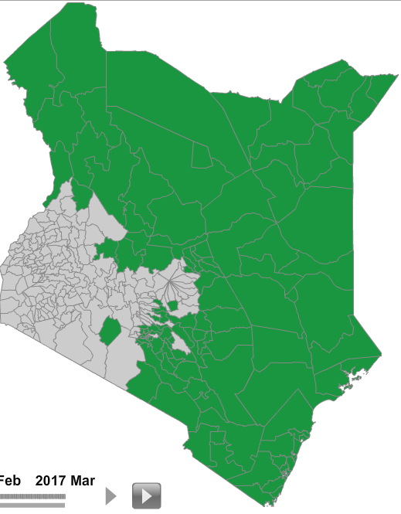
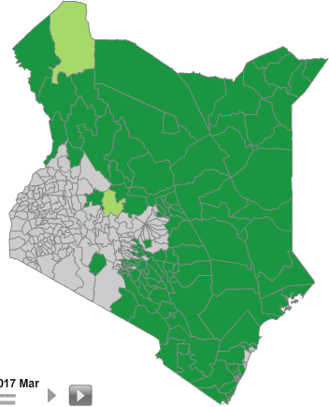
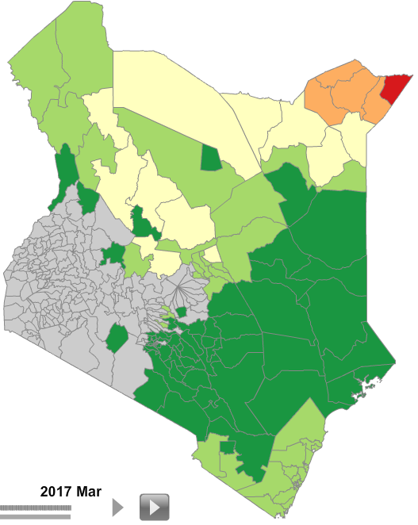
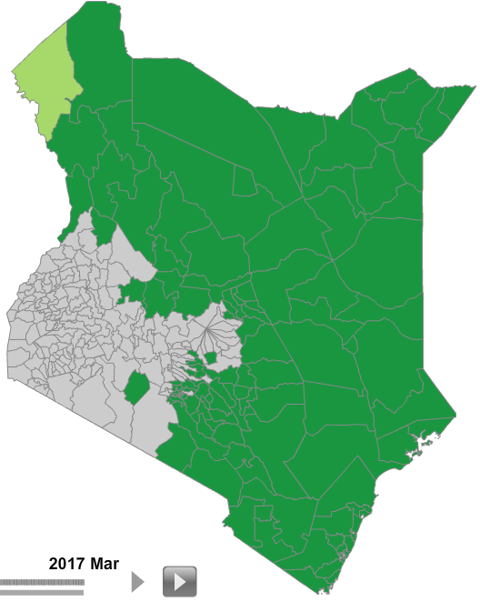
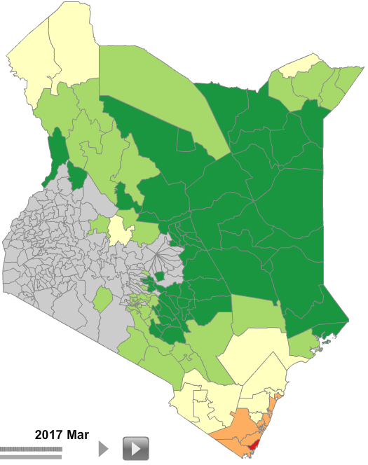
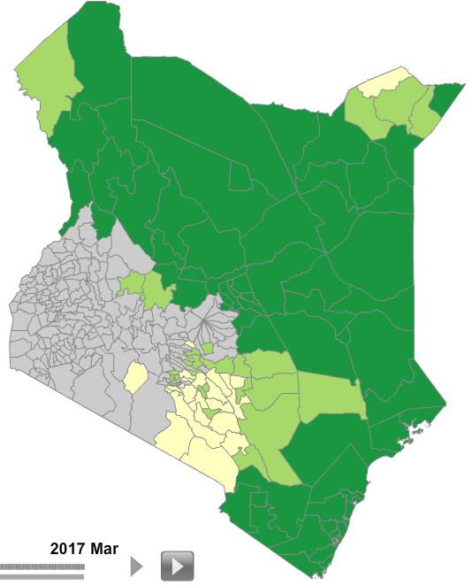
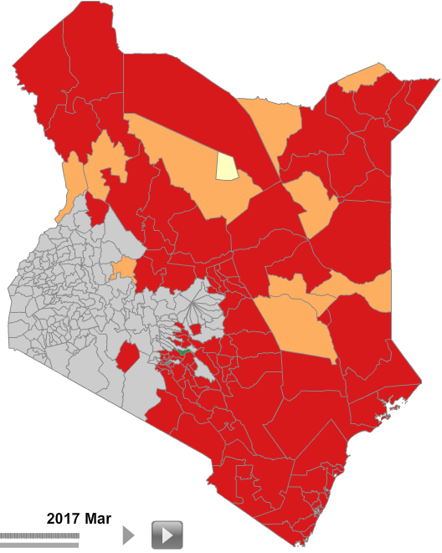
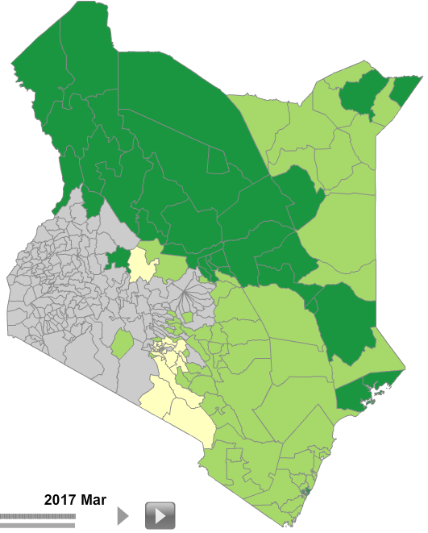
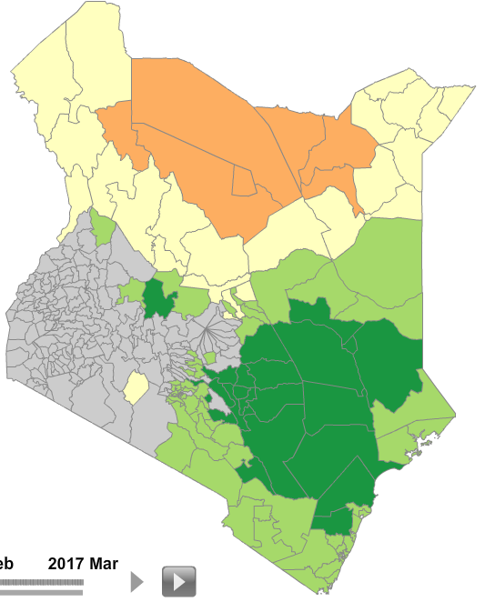
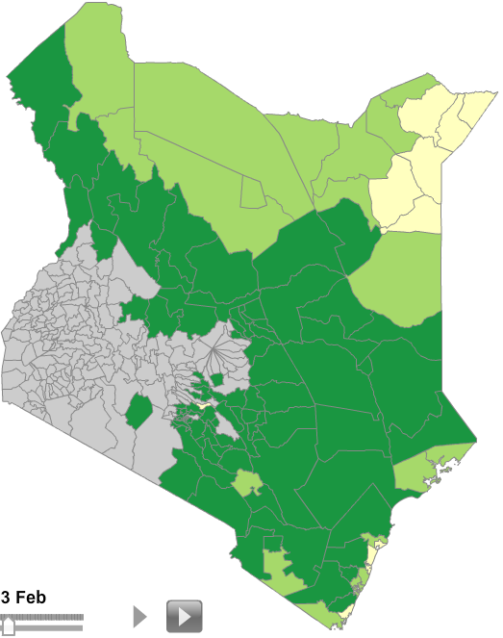
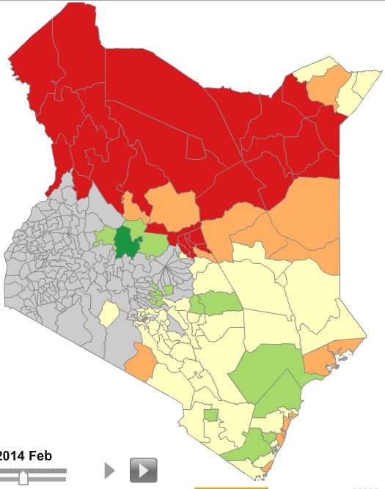
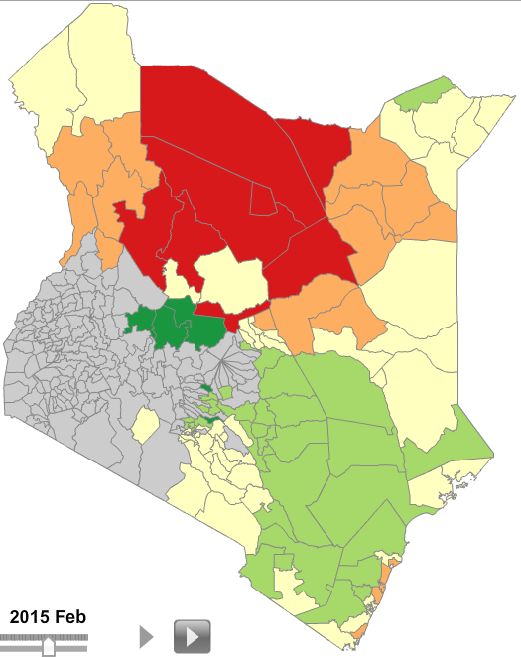
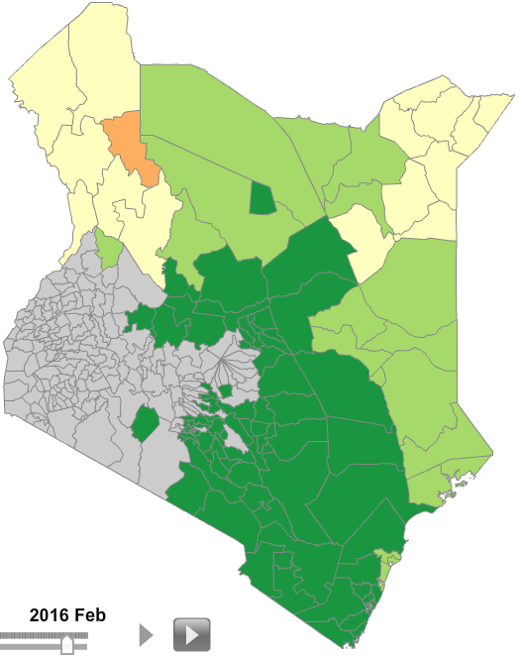
Trend Analysis Predictive Livestock Early Warning Information (PLEWS)
2000
2001
2002
2003
2004
2005
2006
2007
2008
2009
2010
2011
2012
2013
2014
2015
2016
2017
2018
2019
Legend
January
Very good forage
February
Normal forage conditions
Moderate forage deficit
March
Severe forage deficit
Extreme forage deficit
April
No data
May
June
July
August
PLEWs Generated by:
September
October
November
December

Slide 21
Pictorial Evaluation Tool (PET)
Used to assess livestock body conditions
Photo indicators of livestock in a progressive series of body conditions, ranging from very thin to very fat
Based on observation of one highly visible target spot that can be conducted through a quick look and without touching the animal
Available for cattle, goats, fat-tailed sheep, long tailed sheep and camels

Slide 22
Pictorial Evaluation Tool (PET)
PET assessment data are:
Quantitative – scoring of animal body condition against standard body condition grading (from 1 to 5);
Objective – each score is given by the comparison of the observed animal or forage against the standard photo indicators; and
Evidence based – each set of observations is recorded in the app and then stored in a central server, and may be checked at any given moment.
Quick – methodology can rapidly provide reliable data for a specific area and over the variations over time

Slide 23
National Feed Security System

Slide 24
System Activity Flow Sheet
Basis: Learning by doing
7
5
6
PLEWS training to GIS expert & support to partici-pants in integra-ting missing data
START
3
4
First training workshop on generation of potential & actual feed inventory…calculation by participants
Training to participants on data collection for PLEWS
Data collection by participants: PLEWS; on Herd structure; production parameters; competitive feed uses & missing data identified during 1st workshop
1
Awareness building, Task Force prep & Selection of participants
Template & guideline preparation & adaptation for i) data collection, & ii) calculations :
for feed inventory
2
Data collection by partici-pants on cash crops
Scoping study to understand type of data available
11
12
2nd training workshop on (all done by participants) : a) generation of actual feed inventory; b) calculation of ME, CP and DM requirement of animals
Integration of biomass data from PLEWS into Feed Inventory generated during first training workshop
Calculation of feed balance as DM, ME & CP
10
PLEWS data made available
8
14
Participants gather missing data (ident through 2nd⁻Workshop & finalise results (Support for calculations & quality control by Expert)
Creation of ME & CP models tailored to herd structure & production parameters for all animal species
Report writing (Part., Task Force, Expert
15
9
Validation Workshop, dissemin. & publications
Local Tech. review & validation workshop
Quality control of data and calculatio
END
13

Slide 26
Current Coverage
Animal Feed Inventory and Balance
PLEWS
PET

Slide 27
Thank you!
paul.opio@fao.org

