Slide 1
16th IDDRSI Platform Steering Committee Meeting
ETHIOPIA
Progress Report of Resilience Projects
January 2014 to October 2023
Tenth Anniversary of IDDRSI
22-24 November 2023
Entebbe, Uganda

Slide 2
Introduction
Area Coverage
Pastoral and agro pastoral areas represents about 60 % of the Ethiopian total area
60%
Population
Livelihood
12%
Livestock dependent
12% of total population of the country, or more than 12-15 million people, or 2-3 million households are pastoralists and agro-pastoralists
LH of Ethiopian Pastoralists and agro-pastoralists, heavily dependent on livestock rearing.
Livestock Potential
Livestock potential
The area endowed with 22% of the country’s cattle, 40.7% of sheep, 60% of goats and almost 100% of the camel population

Slide 3
Overall goal of DRIs
To contribute for poverty reduction, food security and accelerated sustainable economic growth
The medium and long term objective
To improve livelihood resilience of the pastoral /agro-pastroal communities

Slide 4
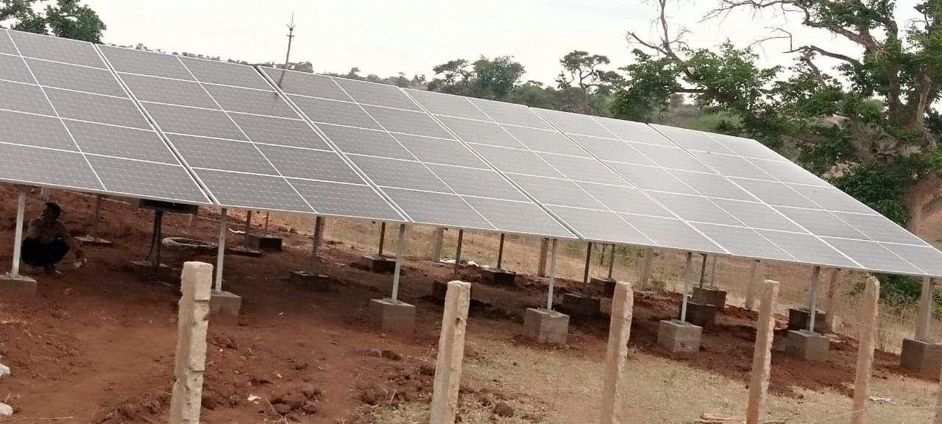
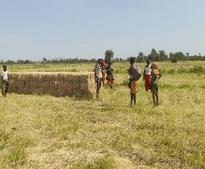
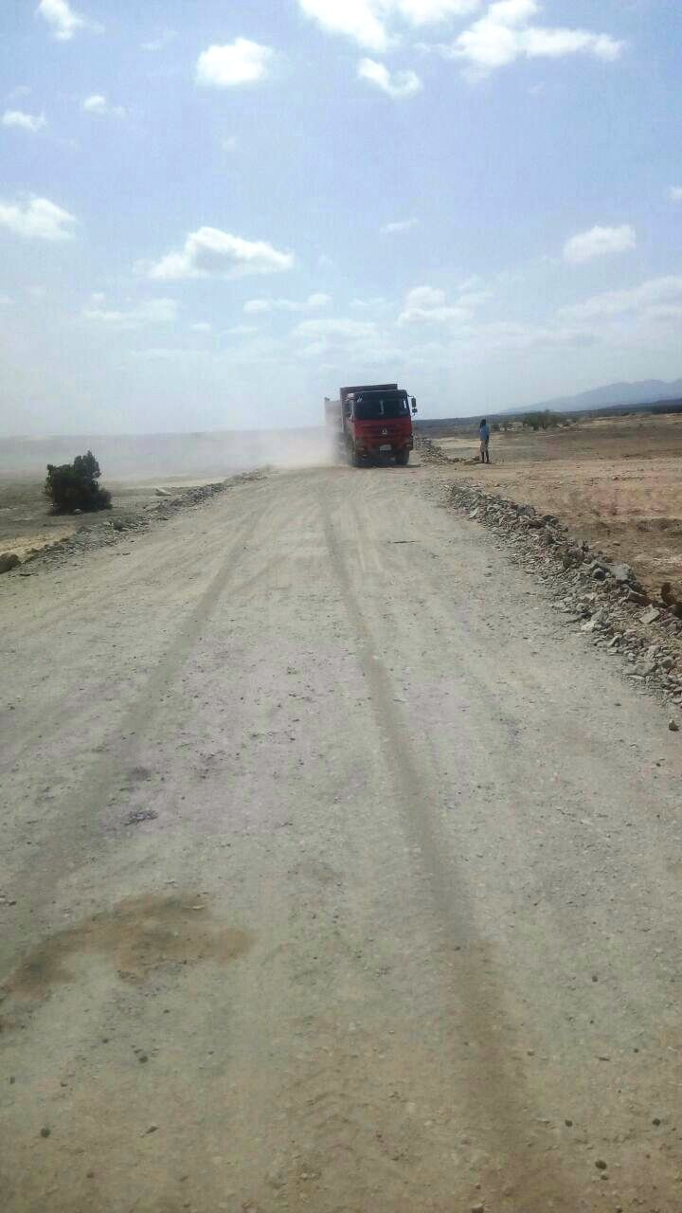
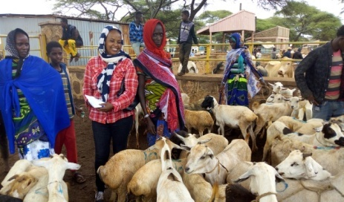
The peculiar feature of DRI is, its approach as integrated development intervention in each project area
Water Development
Rangeland Management
Diversification of Livelihood activities are among the major activities of the Initiative
Livestock Infrastructures Development

Slide 5
Profile of all DRI projects in Ethiopia
No. | Project Title | Financed By | Project start date | Project end date | Project Cost ‘00USD | Target areas
1 | BREFONS | AfDB Grant | August 2022 | December 2027 | USD 40 Million | 30 Woredas (9 in Somali region, 8 in Oromia, 6 in Afar, 5 in SW Ethiopia & 2 in South Ethiopia)
2 | DRIVE | World Bank Grant | June 2022 | September 2027 | USD 115 Million | 187 Weredas, all Pastoral & Agro Pastoral Weredas of five Regions (93 in Somali region, 45 in Oromia region, 35 in Afar region and, 8 in SW Eth. region and 6 in South Eth. region
3 | DRSLP 1 | AfDB Soft loan | October 2013 | December 2023 | USD 46.5 Million | 15 Woredas (6 in Afar region and 9 in Somali region)
4 | DRSLP 2 | AfDB Soft loan | January 2015 | December 2023 | USD 43.5 Million | 15 Woredas (8 in Oromia region 5 in SW Eth. region and 2 in South Eth. region)
5 | RF/ SDR | KfW grant | January 2015 | December 2023 | 13 Mil. Euro | 4 Woredas ( 3 Afar region and 1 in Somali )
6 | DRSLP/AICS | IDC Soft loan | January 2015 | 2014 | 12 Mil. EURO | 4 Woredas (in Afar region)
7 | LLRP | World Bank Soft loan | November 2019 | October 2025 | USD 322.6 million | 100 Woredas (36 woredas in Somali region, 20 Woredas in Afar region, 18 woredas in Oromia region, 6 Woredas in SW Eth region, 3 Weredas in South Eth region, 9 Weredas in Benishangul region and 8 Weredas in Gambela region)
N.B. DRI – Drought Resilience Initiatives

Slide 7
Progress Report of Resilience Projects
January 2014 to October 2023
DRI Ethiopia

Slide 8
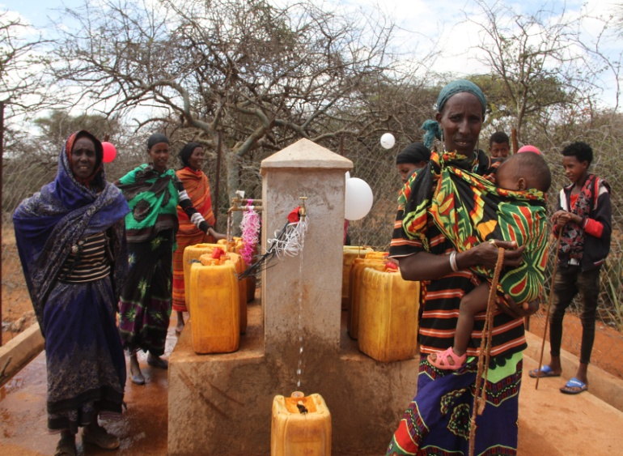
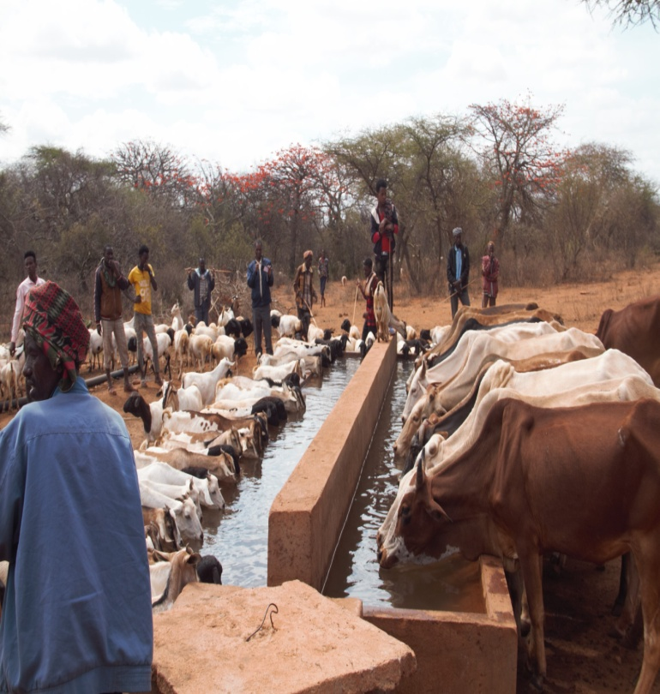
PIA 1: Natural Resources and Environment Management
Component 1: Natural Resource Management
1.1 Water Resources Development & Managements
129 surface water constructed
113 boreholes have been drilled,
38 Water distribution system constructed
As a result of the above Intervention
1.28 Mil. (46% are female) community members and 4 Mil. livestock have got access to improved water supply
137 new small-scale water schemes constructed
238 existing water schemes have been rehabilitated.

Slide 9
As a result of water resource development and management intervention, the following key results were achieved
Water Resources Development & Management Cont.
05
Traveling time to access water resources has reduced from 5 hour to less than half an hour (especially for women & girls)
Women and girls are able to use saved time to engage in productive works and properly managing their domestic responsibilities
04
03
Enhanced sanitation and hygiene and thereby reducing prevalence of water borne diseases
Community are getting clean water supply in sustainable manner
02
01
Reduced traveling distance of animal in search of drinking water and which in turn contribute for improved body conditions and productivity

Slide 10
PIA 1: Natural Resources and Environment Management… Natural Resource Management Con’t…
1.2. Rangelands Management
Fodder development on 7,703 ha of land
Bush Clearing
Fodder Dev’t
217 thousand ha of bush clearing & invasive weed control
As a result:-
2.4million bales of improved pasturee supplied to more than 1.7 million livestock,
benefited more than 370,742 ouseholds.
SWC
Stores
More than 23,396 ha of Integrated SWC.
Construction of 24 hay stores was achieved .

Slide 11
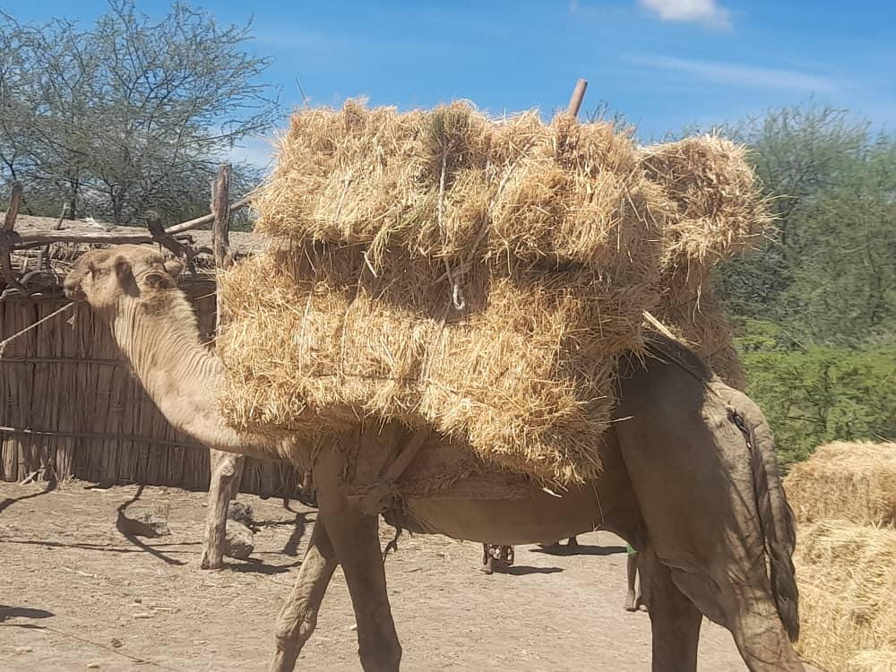
PIA 1: Natural Resources and Environment Management… Natural Resource Management Con’t…
1.2. Rangelands Management

Slide 12
As a result, of the Rangeland Management and Pasture Development activities the following key results were achieved
Rangelands Management Cont…
05
About 370,742 household heads benefited with the supply of fodder for 1,736,975 livestock)
Increased availability of produced hay in the project areas reduced transportation of fodder/hay from the far highland areas.
04
03
The local community adopted hay baling and storing instead of free grazing.
Natural rangeland has been regenerated and restored.
Soil & water conservation activities rehabilitated degraded areas
02
01
Introduction of fodder bank and hay stored availability enable the local community to withstand the shortage of animal feed during the recent incidence of drought

Slide 13
PIA 2: Market Access, Trade and Financial Services
Component 2. MAT: Livestock Infrastructures
LMC
04
New 46 Livestock market centers
6 Existing livestock market centers
02
Health Facilities
Access Road
59 Animal health posts and14 Permanent veterinary clinics
4 mobile veterinary clinics
1,400 kms of feeder road
03
PTC
01
41 New Pastoral training centers,
207 Existing pastoral training centres

Slide 14
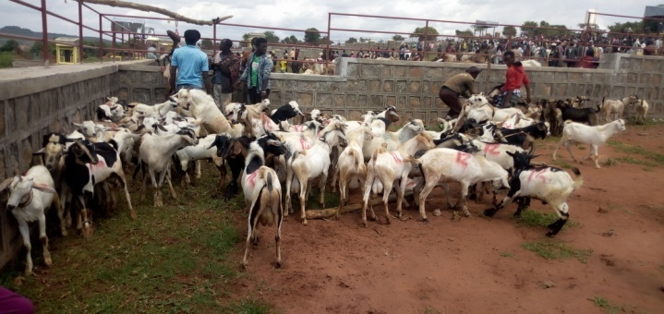
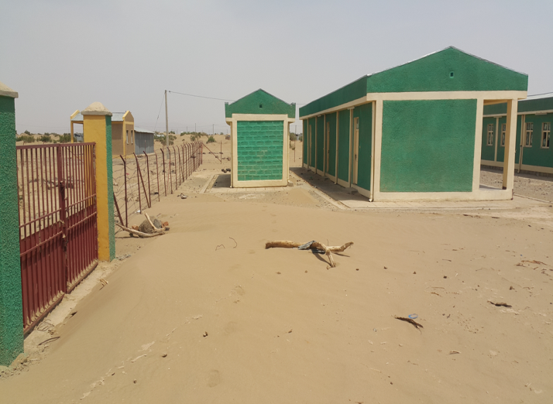
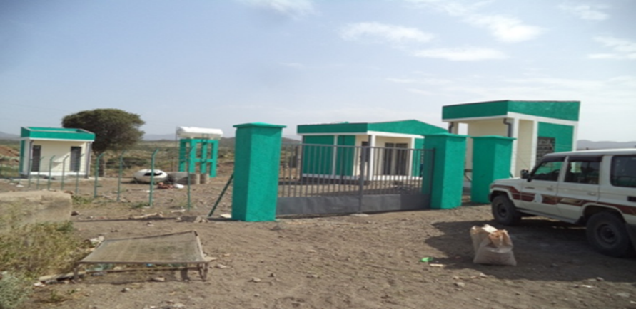
PIA 2: Market Access, Trade and Financial Services
Component 2. MAT: Livestock Infrastructures

Slide 15
PIA 2: Market Access, Trade and Financial Services…
As a result of this, the pastoralists are benefiting the following
01
Market offtake
Market off take has been increased, cheating and robbery decreased; pastoralist able to get better price
Job Creation and income Generation
Municipality started to generate revenue through collecting tax during market days.
Job opportunity created as a result of LMC
02
03
Health Facilities
Livestock death has decreased due to increased animal health delivery services
Improved service delivery capacity of regional laboratories and animal breeding centre
Market creation
04
Livestock market access has created for about 658,900 households including for project target area adjacent woredas and kebeles.
Agricultural/pastoral extension training has been given for 84,380 people (42% female) in the pastoral training centers.

Slide 16
PIA 3 Enhanced Production and Livelihood Diversification
Component 3 - Support to Livelihoods Diversification
280 households have adopted drought tolerant crop varieties promoted (haricot bean & teff )
79.5 mil. Seedlings of fruit, forage and high value crops produced & distributed to 66 thousand HH.
Seedlings
CAHWS
Drought Tolerant Crops
CIG
919 cooperatives with more than 52,430 members (62% female) and 1,680 Common Interest Groups (CIG) with 26,296 members (54% female) were established & provided 686 million Birr support from the initiatives.
1,908 community animal health workers (CAHW's) trained and provided with start up kit.

Slide 17
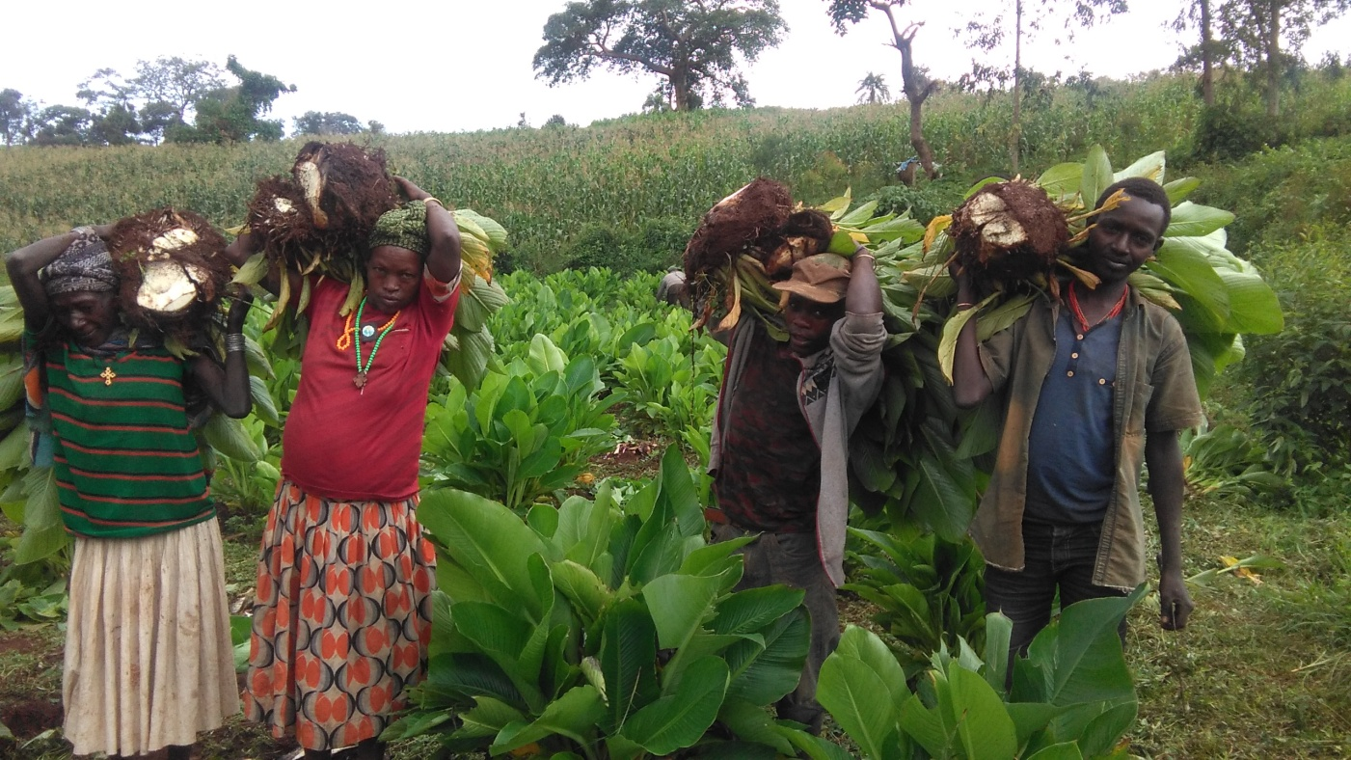
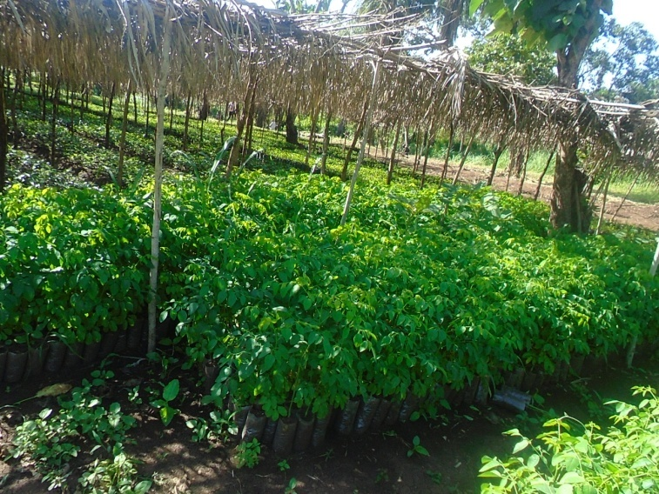
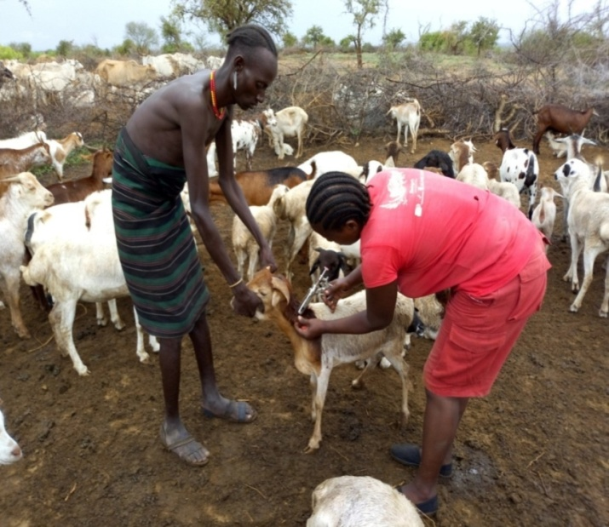
PIA 3 Enhanced Production and Livelihood Diversification
Component 3 - Support to Livelihoods Diversification
As a result :
More than 2.9 thousand livestock were vaccinated against different diseases which benefited more than 383 thousand HHs.
Livelihood diversified
More than 16 million birr profit earned and estimated amount of Birr 21.5 million additional asset built. Moreover members diversified their business & improve their livelihoods.
Livelihood improved
Out of Birr 28.96 million matured loan so far Birr 17.53 million (60%) loan repaid
Seedling Production
Drought tolerant crops
CAHWs giving service
Fattening cooperative

Slide 18
PIA 3 Enhanced Production and Livelihood Diversification
Component 3 - Support to Livelihoods Diversification …. Results
The trained & equipped CAHWs have created their own income source to support their livelihood.
Cooperative members are started to diversify their income sources
Women are economically empowered
Capacity Building
Livelihood diversification
Income Generating
Youth and Women
Cooperative members increased their income
As a result of saving mobilized cooperatives internal resource increased.
The poorest of the poor have created additional assets.
Jobless rural youths have created their own income generating activity

Slide 19
PART
Challenges and Lessons Learnt during the Last Ten Years

Slide 20
Major Challenges
Inflation and price escalation for construction materials
Limited capacity of contractors
Incidence of recurrent drought in lowlands
Flooding due to overflow of river in some regions
Weak attention of stakeholders to support the implementation
Conflicts in some areas of the country
Weak institutional capacity at pastoral community level.
Capacity limitations at all levels (federal, regional and woreda)

Slide 21
Lessons Learnt
Program Priority Area (PIA) 1.Natural Resource Management (NRM):
Water development is still the fundamental point to change the livelihood of pastoral community.
The rangeland rehabilitation and forage development was uncommon practice to the pastoral community and reduction in travelling long distance- (save time and labour especially for women).
Fodder bank management has boosted the preparedness capacity of the community to mitigate the risks of natural disaster.
Lessons Learnt
Hay making helped in creation of asset building opportunities and income
Hay making contributed to peace and security through reduced conflicts and cattle riding problems on search of feed.
All together brought behavioural change of the community to engage in different development activities

Slide 22
Lessons Learnt contd
Program Priority Area (PIA) 2. Market, Trade and Financial service (MAT):
Fattening and marketing through market linkages of CIGs, helped as diversified income source for pastoralists.
Market Linkage
1
Establishment (CIGs ), Rural Saving and Credit cooperatives (RuSACCOs) and (CAHWs) helped the introduction of technologies/inputs and service.
CIG
2
Job Opportunity
3
LMCs created
social inter-actions among different ethnic groups, which in turn attributed to reduce conflict incidences.
job opportunities for service provider women and youth groups, petty trade, transportation service using motorbikes. It has started generating revenue for the town municipalities.
Formal Trade
4
opportunity for improvement of formal cross border trade that can be served as an entry point for any development interventions.

Slide 23
CIG
Women
Technology
Lessons Learnt contd
Establishment of cooperatives (IGA groups) CAHWs and CBGs helped the introduction of different crop technologies/inputs and service delivery (animal health/vaccination), that brought additional income source and job opportunities to pastoral areas
The forage seed production and practiced adoption technology were also expanded by other partners and generated income and enhanced asset building for the households that resulted in social prestige’s to the members
Fattening and marketing of small ruminants through market linkages helped as diversified income source for pastoralists, in particular for women
Program Priority Area (PIA) 2. Market, Trade and Financial service (MAT):

Slide 24
PART
Recommendation and Way Forward

Slide 25
Recommendations for the Implementation of IDDRSI from 2024 to 2027
CFocus on large water infrastructure development as an entry point and nucleus for implementations of all PIAs.
Design integrated and community based interventions (water resource development, forage development, livestock infrastructure development,…)
Livestock development should be based on the value chain development principles in integrating and harmonizing all producers, service providers and other actors. This will create a diversified job opportunity within the livestock subsector and ensures sustainability and improve livelihood of pastoralist.
Integrated Approach
Asset Building
Consider Value chain
Future interventions also need to focus on production based asset building and household level small agro-processing practices

Slide 26
PART
Progress on the Implementation of Recommendations of 15th PSC

Slide 27
Performance along the Recommendations of 15th PSC
Recommendation | Key Areas of Focus
5. Noting that the arid and semi-arid lands in the region are facing water scarcity for human beings, livestock and agriculture and recalling recommendation 14.4, call upon all stakeholders to intensify investment in water development to ensure that communities in the ASALs have sustainable access to safe water through bringing “water to the people” approach that would also address their needs for water for livestock, crop and fruit production. | The AfDB financing BREFONS intervention aims at enhancing the provision of water as an entry point, to improve livestock production, fodder and horticulture production, rangeland management and Agri-business development activities.
7. IDDRSI Stakeholders remain deeply concerned about the disproportionately low level of funding to protect livelihoods in the region challenged by multiple crises, and this, unfortunately, is resulting in a multi-faceted humanitarian crisis (including water and sanitation, health, food, displacement, protection GBV, etc.) in our region. Member States, Partners and the private sector are therefore urged to enhance investment in safeguarding livelihoods and prevent hazards from turning into humanitarian crises. | The WB has ongoing operations benefitting pastoralists such as De-risking Inclusion and Value Enhancement of Pastoral Economies, the Groundwater for Resilience Project, Lowland Livelihood Resilient Project, Emergency Locust Response Program and AfDB projects such as food and nutrition security and Drought Resilience and Sustainable Projects.

Slide 28
Performance along the Recommendations of 15th PSC ..Contd..,
Recommendation | Key Areas of Focus
8. While addressing the immediate needs of vulnerable people and saving lives is a top priority, all stakeholders are urged to give livelihood adaptation and the building of resilient food systems that would reduce poverty, food insecurity, displacement, and ultimately, conflict over natural resources through increased budgetary allocation for investment in resilience. | AfDB supports pastoralist food systems through the program to build resilience for food and nutrition security and enhance adaptive capacity of the pastoral community and better prepare for and manage climate change, climate risks, and climate variations. Besides, in pastoral areas of Ethiopia DRIVE supports a sustainable response to drought through package financial services for climate resilience.
12. Appreciating the role of science, technology and innovation in driving resilience, all stakeholders, especially the Member States, are urged to bolster the roles of research and extension systems in promoting resilient agriculture to bridge the current gaps in pastoral and agro-pastoral production systems. | The AfDB financing BREFONS will support facilitating access to Climate-smart, Innovations and Technologies and digital advisory services to enhance productivity, improve disease surveillance, help farmers to access market and financial services as well as reducing their vulnerability and exposure to climate risk.

Slide 29
THANK YOU!

