Slide 1
IGAD Resilience Index (IRI)
Entebbe, Uganda
22 November, 2023
$$Well−being=f\left(Resilience capacity,Shocks\right)$$

Slide 2
Introduction
“What gets measured gets improved”. If we cannot measure resilience, it is challenging, if not impossible, to know the effectiveness of our resilience-strengthening interventions or to make data-driven decisions to manage and conceptualize resilience and improve it as necessary.
While progress has been made globally, on resilience measurement and analysis, how evidence from such measurement activities may support country and regional level decision making requires a focused response. To be effective, resilience measurement evidence is required to be more directly connected to decision making within countries and across regions.

Slide 3
IGAD Resilience Index (IRI)
The IGAD Resilience Index (IRI) is a collaborative and demand driven effort that seeks to meet stakeholders’ needs for evidence that has both technical rigour and practical value.

Slide 4
Assessment process
There are 9 high-level indicators, assessed with 25 criteria and 31 sub-criteria, and 11 attributes.
Each of the nine overarching indicators (along with their corresponding criteria) will be categorized within a minimum of one of the capacities: Transformative, Anticipatory, Absorptive, and Adaptive, which are embraced by both the TANGO and RIMA-II frameworks.

Slide 5
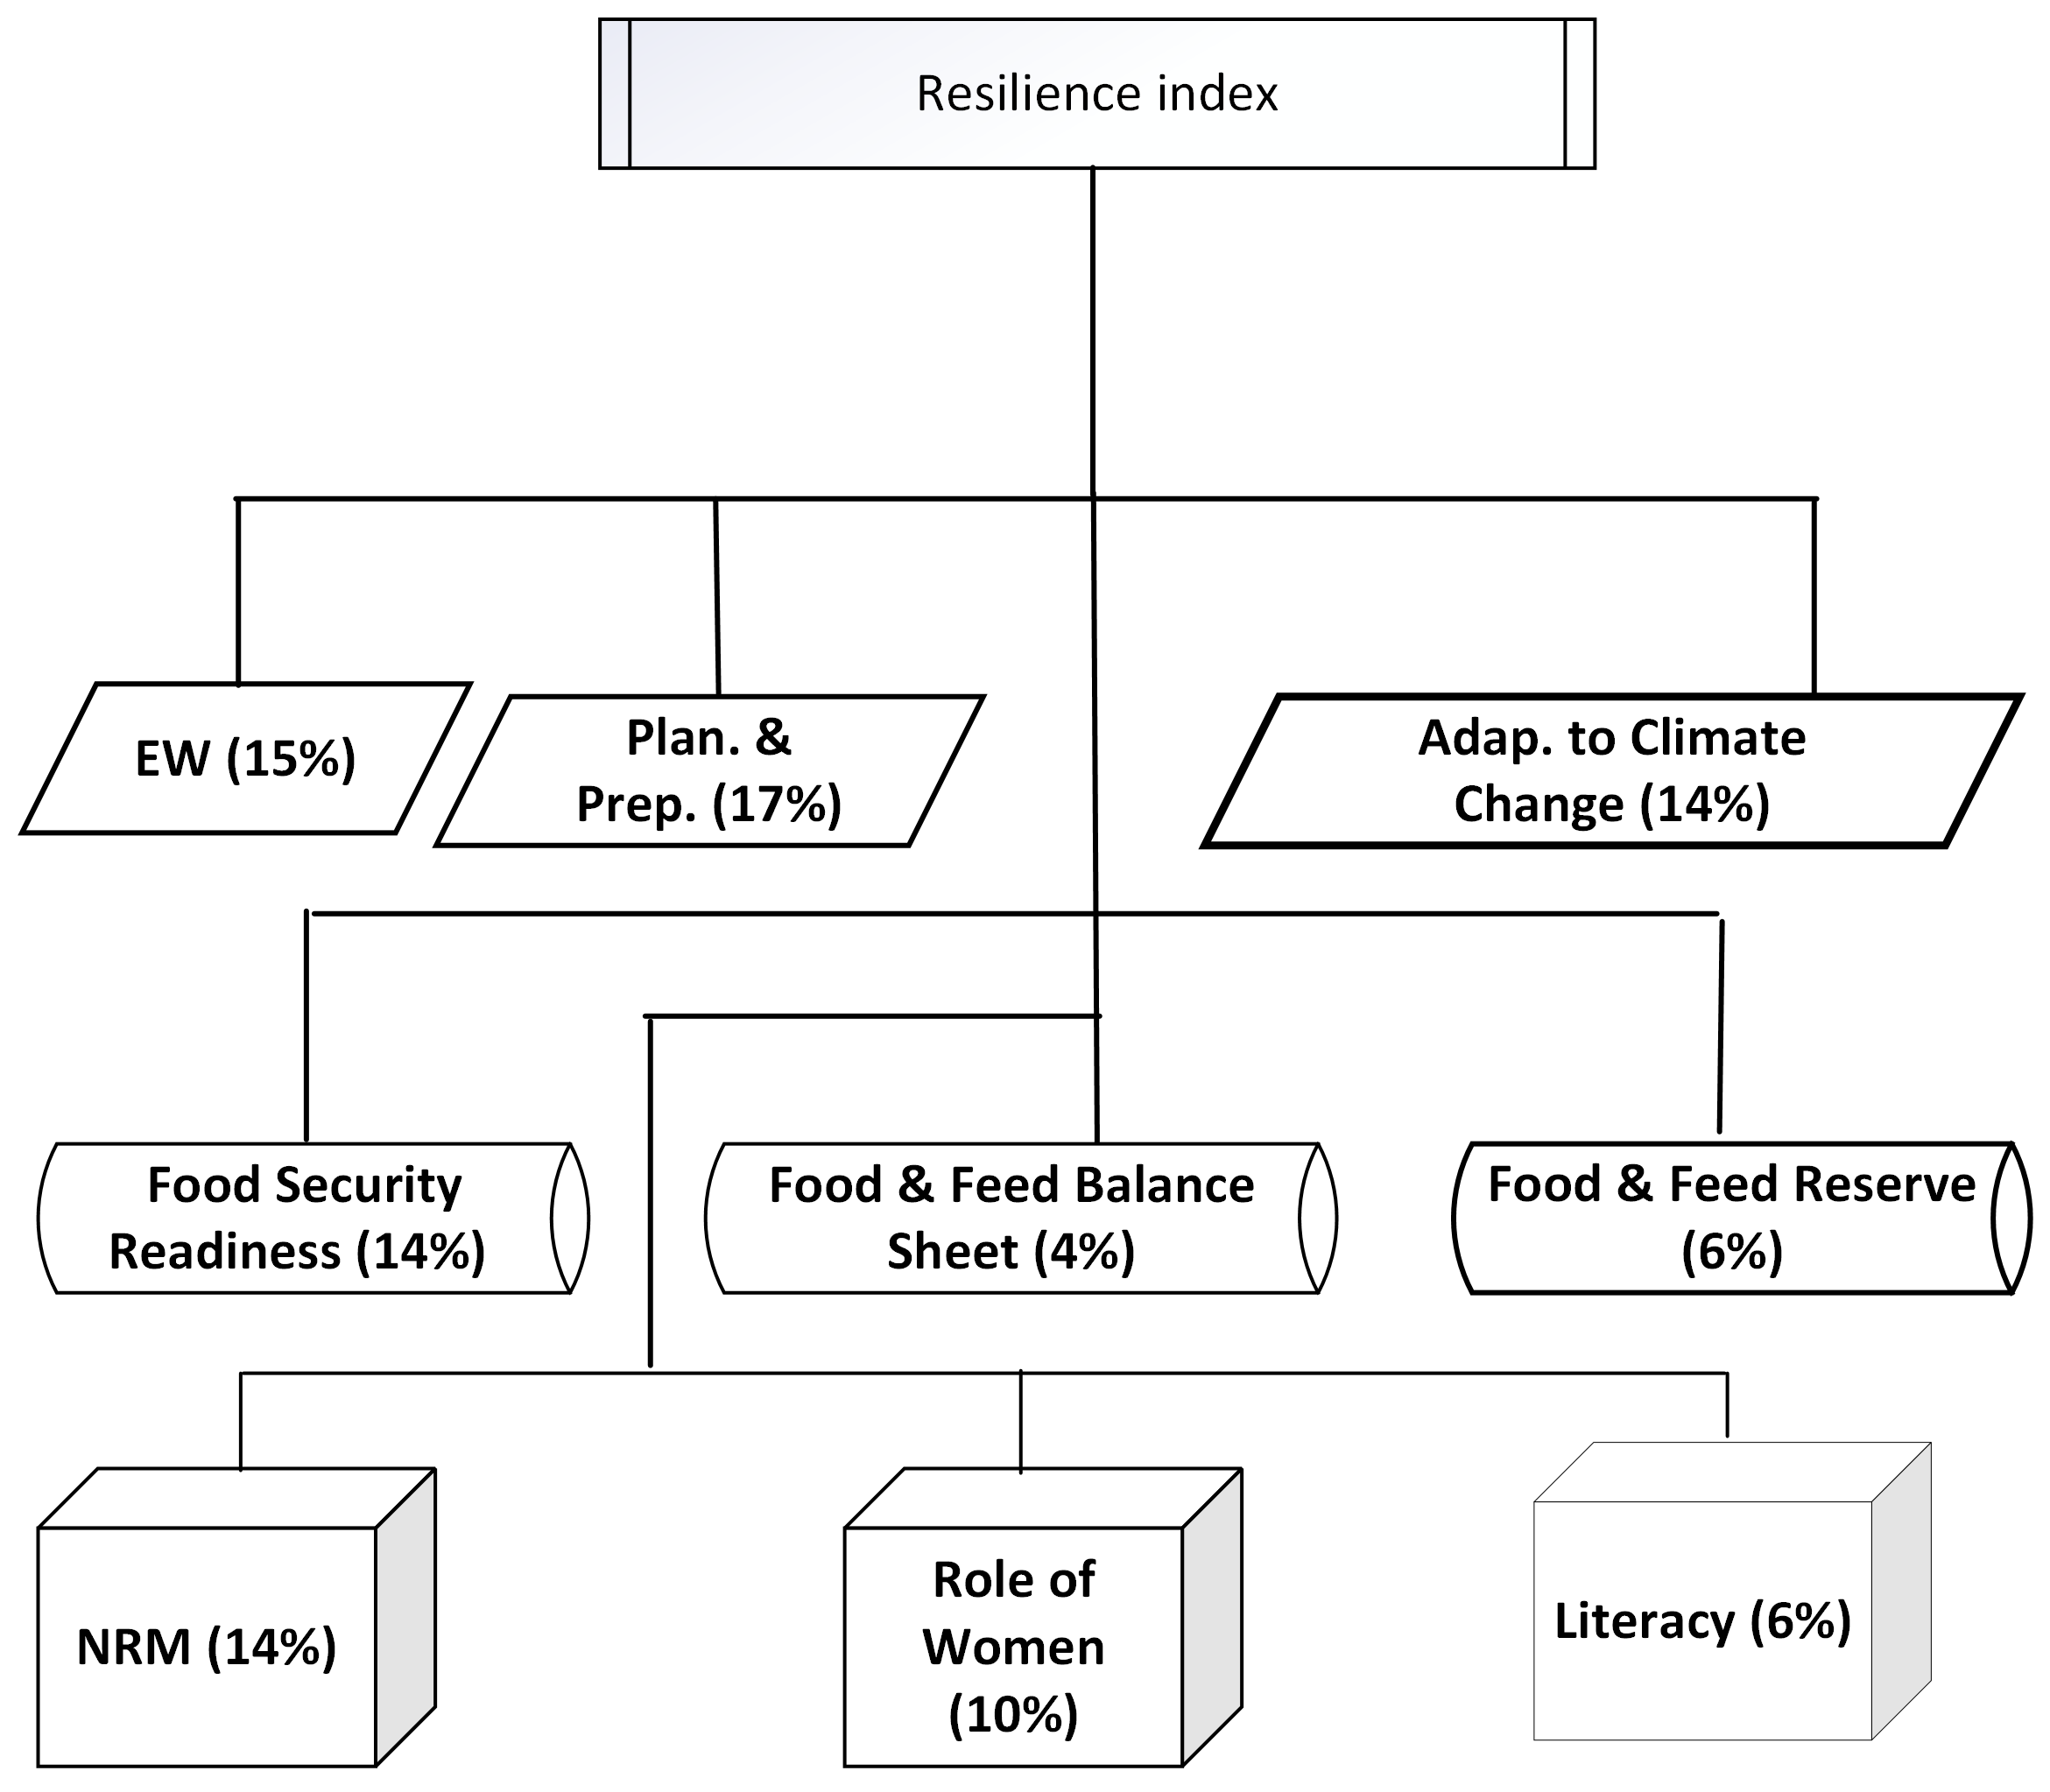
Assessment process

Slide 6
Assessment process
The total resilience index for a specific country is determined by adding up the normalized scores of the high-level indicators, as outlined in the Equation .
${RI}_{n}=y_{1}X_{1}+y_{2}X_{2}+y_{3}X_{3}……..y_{9}X_{9}$
This index has a potential range of values from zero to one hundred. To arrive at this index, initially the individual indexes for all nine resilience capacity indicators are computed. These individual indicators are then synthesized to form a comprehensive measure of resilience for that country.

Slide 7
Assessment process
RI_{n} | State of resilience | Colour code
< 40 | Crises
>= 40 and < 60 | Concern
>= 60 and <75 | Moderate
>=75 | Resilient

Slide 8
Weighing Process
The Analytic Hierarchy Process (AHP) was applied to initiate the weighing process. The AHP involves a series of pairwise comparisons wherein each element (indicator, criterion, or sub-criterion) is compared against every other element.

Slide 9
The comparisons are made using a scale ranging from 0 to 1, allowing for a quantitative assessment of their significance.
The results obtained through the AHP process were shared and discussed in a workshop involving subject matter experts, representatives from IGAD member states, the IGAD Secretariat, Specialized Institutions, and other stakeholders.

Slide 10
Weighing Process
Notably, representatives from member states actively participated in this weighing process, considering the unique circumstances and contexts of their respective countries. Their active involvement ensured that the weights assigned were meaningful and reflective of their countries' realities and specific contexts.

Slide 11
Weighing Process
Following the workshop, the feedback and insights provided by the experts, particularly the representatives from member states, were integrated into the weighing system.
This integration enhanced the accuracy and relevance of the weights assigned to indicators, criteria, and sub-criteria. The protocol then underwent a pilot phase in Ethiopia, Kenya, and Uganda, where its effectiveness and practicality were assessed in real-world settings.

Slide 12
Indicators, Criteria Sub-Criteria & Attributes
Indicator | Criteria | Sub-criteria
Drought Early Warning System (15%) | Forecasting (50%) | Precipitation (22%)
 |  | Soil moisture (10%)
 |  | Vegetation conditions (15%)
 |  | Combined Drought Index (53%)
 | Monitoring and Observation (30%) | Reservoir water level (17%)
 |  | River discharge (17%)
 |  | Groundwater conditions (16%)
 |  | Vegetation conditions (33%)
 |  | Soil moisture (17%)
 | Communication and outreach (20%) | Communication strategy (100%)
Calculation procedure | Dichotomous Question Type, with Yes/No answer. Yes = 1, No = 0
 |  | Sub-criteria score = answer of the question * its weight
X_{s} = Weighed criteria score
I_{w} = Indicator weight

Slide 13
Indicators, Criteria Sub-Criteria & Attributes
Planning and preparedness for drought (17%) | Proportion of the population supported by the social protection programs (20%)
 | Government spending on basic services, as percentage of total government spending (35%)
 | Proportion of the population experiencing moderate and severe food insecurity (25%)
 | Existence of formal drought preparedness and response manual (20%)
((sum(X₁₋₄)*w₁₋₄))*W_{ind-2}

Slide 14
Indicators, Criteria Sub-Criteria & Attributes
 | Indicator | Criteria | Observed Value | Indicator value
3 | Adaptation to Climate Variability (14%) | Vulnerability
 |  | Readiness to climate variability
ND-GAIN Score = (((Readiness Score – Vulnerability Score + 1) * 50)/100))*0.14

Slide 15
Indicators, Criteria Sub-Criteria & Attributes
Food Security Readiness (14%) | Affordability (40%) | Proportion of unemployed work force (20%)
 |  | Dependency ratio (15%
 |  | Proportion of people living below the national poverty line (16%) | Member States' Ministries of Agriculture
 |  | Proportion of farmers/pastoralists with access to financial services (49%) | Countries' reports on Malabo Declaration

Slide 16
Indicators, Criteria Sub-Criteria & Attributes
Food safety (16%) | Existence of Legal and Institutional Frameworks on Food Safety (50%) | Existence of Food Safety Regulations and Policies (30%) | Existence of competent regulatory institutions with clear mandates and coordination mechanism (50%)
 |  |  | Existence of national food safety policy, act or law updated at least in the last 10 years and covering the entire food chain (30%)
 |  |  | Existence of risk based food safety standards for at least 5 priority commodities (20%)
 |  | Existence of quality monitoring and surveillance programs (20) | Existence of a risk-based and coordinated food safety monitoring/surveillance plan (40)
 |  |  | Existence of a national epidemiological database/system for storing information on food borne disease (30%)
 |  |  | Existence of a food safety response system with standard operating procedure, traceability and recall system (30%)
 | Water Supply and Sanitation (50%) | Proportion of people with access to improved water supply (60%)
 |  | Proportion of people with access to improved sanitation (40%)

Slide 17
Food Security Readiness (10.5%) | Availability (44%) | Proportion of public expenditure in agriculture (29%) | Ratio of public expenditure in agr. to the total public expenditure (45%) | Countries' reports on Malabo Declaration
 |  |  | Ratio of annual public agri expenditure in the total agriculture value added (35%)
 |  |  | Proportion of Official Development Assistance (ODA) committed to implement the NAIPs disbursed to country (20%
 |  | Quantity of fertilizer use Kg per hectare of arable land (20%) |  | Countries' reports on Malabo Declaration
 |  | Proportion of irrigated area to the total irrigable land (15) |  | Countries' reports on Malabo Declaration
 |  | Proportion of farmers/pastoralists having access to Agricultural Advisory Services (10%) |  | Countries' reports on Malabo Declaration
 |  | Proportion of Agricultural Research Spending as a share of AgGDP (7%) |  | Countries' reports on Malabo Declaration
 |  | Proportion of adult agricultural population with ownership or secure land rights over agricultural land (35%) |  | Countries' reports on Malabo Declaration

Slide 18
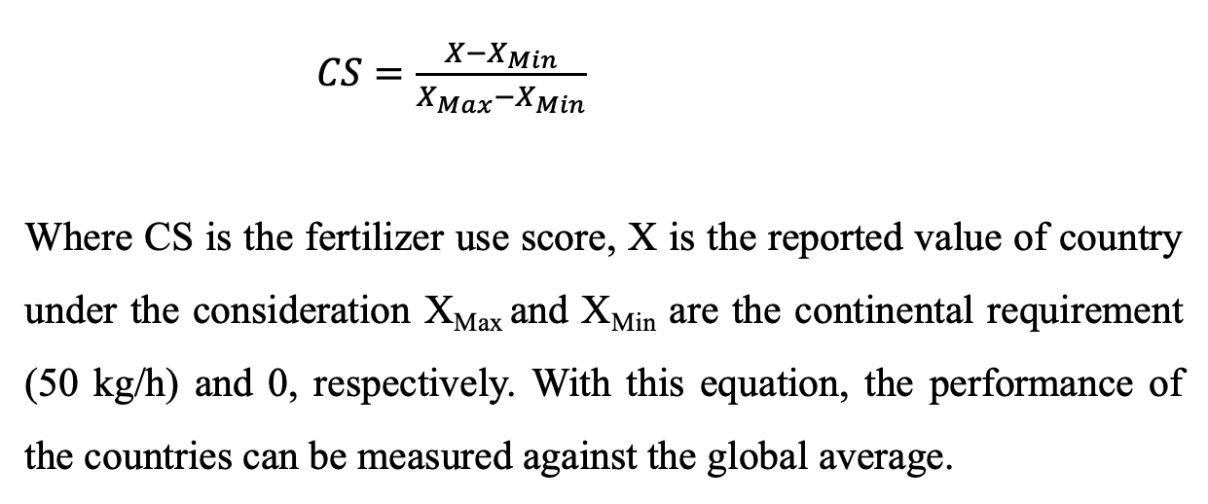
Indicators, Criteria Sub-Criteria & Attributes
$CS=\frac{X−X_{Min}}{X_{Max}−X_{Min}}$
Where CS is the fertilizer use score, X is the reported value of country under the consideration X_{Max} and X_{Min} are the continental requirement (50 kg/h) and 0, respectively. With this equation, the performance of the countries can be measured against the global average.

Slide 19
Indicators, Criteria Sub-Criteria & Attributes
Indicator | Criteria | Source of Data
Food and feed balance sheets (4%) | Food Balance Sheet (67%) | Countries' Ministries of Agriculture + Statistics Bureaus
 | Feed Balance Sheet (33%)
Balance sheet available | Yes (1) | No (0)
Indicator | Criteria | Source of Data
Food and feed reserve (6%) | Food reserve (67%) | Countries' Ministries of Agriculture
 | Feed reserve (33%)
Food and feed reserve established | Yes (1) | No (0)

Slide 20
Indicators, Criteria Sub-Criteria & Attributes
Indicator | Criteria | Sub-criteria | Source of Data
Natural Resources Management (14%) | Sustainable Energy (32%) | Electricity Access (47%) | SDG 7
 |  | Clean Cooking (8%)
 |  | Renewable Energy (27%)
 |  | Energy Efficiency (18%)
 | Integrated Water Resources Management (46%) | Enabling environment (41) | SDG Reports
 |  | Institutions and participation (45)
 |  | Management instrument (39)
 |  | Financing (37)
 | Sustainable Land Management (22%) | Proportion of agricultural land under SLM | Malabo Biennial Reports

Slide 21
Indicators, Criteria Sub-Criteria & Attributes
Indicator | Criteria | Source of Data
Roles and extent of women's engagement in agriculture sector (10%) | Proportion of women that make decisions about agricultural production (18%) | Malabo Report
 | Proportion of women that have access to and decision-making power about productive resources (20%) | Malabo Report
 | Proportion of women that have control over use of income (22%) | Malabo Report
 | Proportion of women that is in leadership in the community (40%) | Malabo Report

Slide 22
Indicators, Criteria Sub-Criteria & Attributes
 | Indicator | Criteria | Source of data
 | Literacy (6%) | Average adult years of schooling | Member States’ Ministries of Education + UNDP's HDI reports
 |  | Expected years of schooling
MYS = Mean years of schooling; EYS = Expected years of schooling. The mean years of schooling is 15 and is the projected maximum of this indicator for 2025, whereas the expected years of schooling is18, which is equivalent to achieving a master’s degree in most countries

Slide 23
Indicators, Criteria Sub-Criteria & Attributes
Total resilience Index (RI) = SUM(weighed Inficators)*100;
Ranges between 0 and 100

