Slide 1

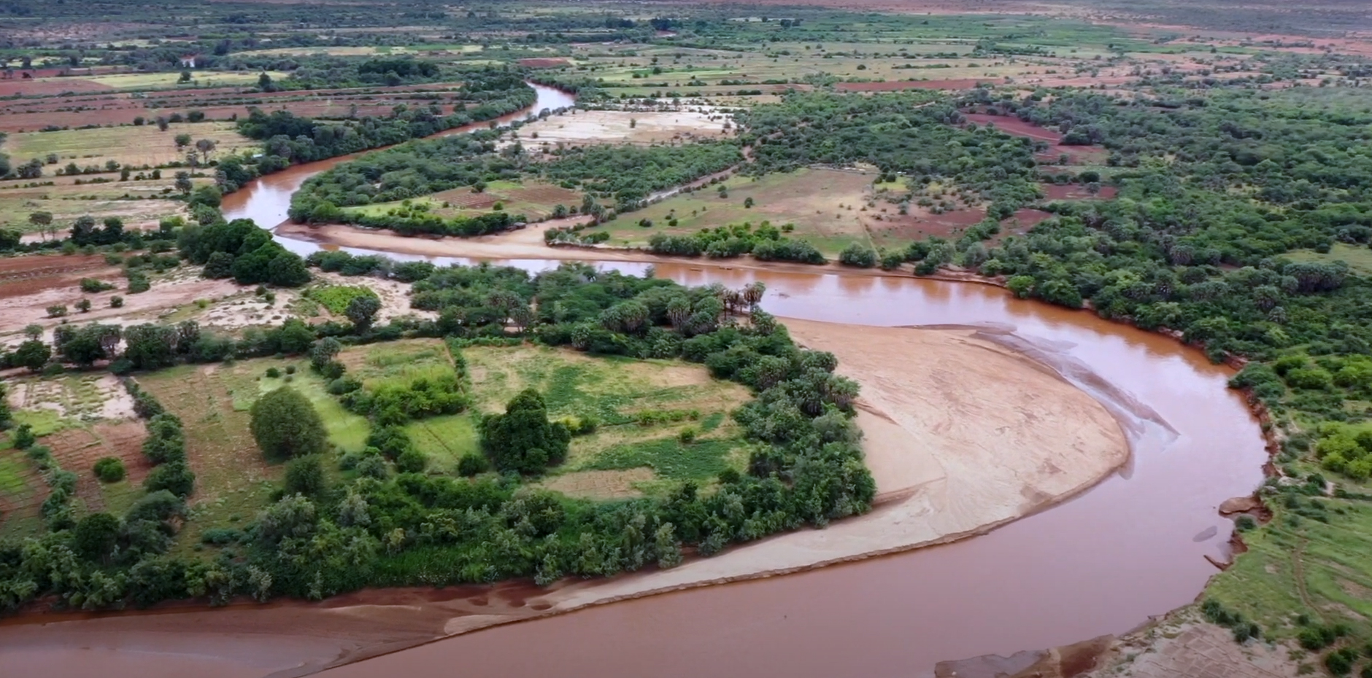
10th Anniversary
16th IDDRSI Platform Steering Committee Meeting
and 9th General Assembly
Progress Report of Resilience Projects in South Sudan
PRESENTED BY:
MR JOHN O. PANGECH, IDDRSI PSC MEMBER
22-24 November 2023
Entebbe, Uganda

Slide 2

PRESENTATION STRUCTURE:
Introduction to South Sudan
Progress on the Implementation of Recommendations of 15th IDDRSI PSC
Updates on the Implementation of the Resilience Projects in South Sudan
Challenges and Lessons Learnt during the Last Ten Years
Recommendations for the Implementation of IDDRSI from 2024 to 2027

Slide 3
Introduction:
South Sudan is a landlocked country that falls almost entirely (96%) within the Nile River Basin in East-Central Africa.
It is bordered in the north by Sudan, by Ethiopia and Kenya in the east, by Uganda and the Democratic Republic of the Congo (DRC) in the south, and in the west by the Central African Republic.
The country attained its independence on 9th July 2011.
It occupies an area of 658,842 sq. km (including Abyei) and is inhabited by 12.5 million persons.
The country is administratively divided into ten (10) states and three (3) Administrative Areas.

Slide 4


Slide 5
South Sudan is endowed with six agro-climatic zones, namely; the Green Belt, the Hills and Mountains, the Flood Plains, the Ironstone Plateau, the Nile-Sobat Rivers, and the Semi-arid/ Pastoral Zones
River Nile and the ‘Sudd’, the world’s most extensive wetlands, confer a huge irrigation potential that would increase the arable area and extend growing seasons.
The Sudd, that is covering an area of about 57,000 sq.km, has been designated as world heritage site under the Ramsar Convention on Wetlands in June 5, 2006.
15-20% of South Sudan is drylands and ASALs and these are more affected by the vagaries of climate.

Slide 6
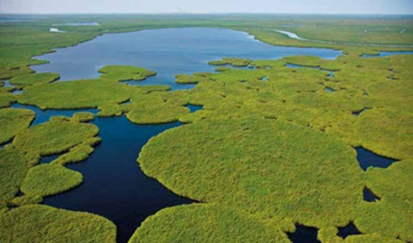

Slide 7
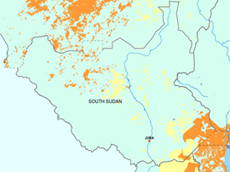
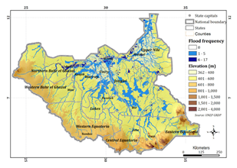

Slide 8
Key Progress on the Implementation of Recommendations of 15th IDDRSI PSC
S/NO. | 15th PSC RECOMMENDATIONS | SOUTH SUDAN’S ACHIEVEMENTS
15.1 | Recalling recommendation 13.5 to support Member States in establishing a national architecture for climate financing and acknowledging continued threats of Climate Change on the lives and livelihoods of our people, calls upon IGAD to support Member States to tap into opportunities created under the climate change regime facilitated by UNFCCC, especially the outcomes of COP27, in climate finance, adaptation, loss and damage, resilience building, technology transfer and capacity building. | The Ministry of Environment and Forestry of the Government of South Sudan witnessed signing of a $ 10 million dollar project for establishing a national early climate warning system for the country in Juba, on 11th August 2023. The five-year deal was signed between the United Nations Development Program (UNDP) and the IGAD Climate Prediction and Application Centre (ICPAC). The initiative targets collection, analysing, and reporting data related to climate patterns. The project will establish an Early Warning System and the building of the Capacity of the Meteorological Department.

Slide 9
Key Progress on the Implementation of Recommendations of 15th IDDRSI PSC
S/NO. | 15th PSC RECOMMENDATIONS | SOUTH SUDAN’S ACHIEVEMENTS
15.1 | Cont’d | The system will provide timely weather information and alert citizens of climate hazards such as floods, droughts, heat waves and storms. The first phase of the project will cover Central Equatoria and Eastern Equatoria states, the most drought prone areas. Furthermore, the Ministry has developed the Second Nationally Determined Contributions (NDC), The National Adaptation Program of Action (NAPA), and the first National Adaptation Plan (NAP).

Slide 10
Key Progress on the Implementation of Recommendations of 15th IDDRSI PSC
S/NO. | 15th PSC RECOMMENDATIONS | SOUTH SUDAN’S ACHIEVEMENTS
15.6 | Recognizing the pivotal role of access to basic social services, urge Member States and Development Partners to improve the infrastructure (roads, markets, energy, health, education and ICT) to create a conducive environment for the ASALs. | The Ministry of Roads and Bridges of the Government of South Sudan has embarked on the construction of High-Way Roads linking the states capital towns to Juba to provide sustainable road access and quality of transport services for the communities in the zone of influence to markets and social services and contribute to the reduction of poverty and promote good governance, peace and security. Movement of goods including livestock across the country will improve, hence creating an enabling environment for ASALs. Examples are as follows:

Slide 11
Key Progress on the Implementation of Recommendations of 15th IDDRSI PSC
S/NO. | 15th PSC RECOMMENDATIONS | SOUTH SUDAN’S ACHIEVEMENTS
15.6. | Cont’d | Juba-Bor-Ayod-Malakal-Ring-road; 200 km implemented. -Juba-Terekaka-Rumbek-Wau-Aweil; 65 Km implemented. -Upgrading of the Nadapal-Juba Road, 341.2km, from gravel to paved (bitumen) standard.

Slide 12
Key Progress on the Implementation of Recommendations of 15th IDDRSI PSC
S/NO. | 15th PSC RECOMMENDATIONS | SOUTH SUDAN’S ACHIEVEMENTS
15.7 | IDDRSI Stakeholders remain deeply concerned about the disproportionately low level of funding to protect livelihoods in the region challenged by multiple crises, and this, unfortunately, is resulting in a multi-faceted humanitarian crisis (including water and sanitation, health, food, displacement, protection GBV, etc.) in our region. Member States, Partners and the private sector are therefore urged to enhance investment in safeguarding livelihoods and prevent hazards from turning into humanitarian crises. | The European Union Delegation in South Sudan has launched a Multiannual Indicative Programme (MIP) for South Sudan for 2021-2027. The cost amounts to €208 million. Priority areas: -Green and resilient economy' will address the following interlinked sectors: food and nutrition security, sustainable agriculture and livestock, land, biodiversity and energy efficiency; -Human development: education and health; -Good governance, Peace and Rule of Law for a fairer society: peace and reconciliation, access to justice, accountable and inclusive governance and human rights.

Slide 13
Key Updates on the Implementation of the Resilience Projects: January 2014 to October 2023:
PIA 1: Natural Resources and Environment Management
Major Projects implemented with budget utilisation in USD
No. | Title of Project | Duration of the Project | Utilised Budget (USD)
 | Irrigation Development Master Plan (IDMP) | 2012/2015 | 9.5 million
2. | Building Resilience for Food and Nutrition Security in the Horn of Africa (BREFONS)- South Sudan Component | 2022-2027 | 26.37 million
3. | Regional Climate Resilience Program (RCRP) | 2023/2028 | 215 million
4. | Strategic Water Supply and Sanitation Improvement Project (SWSSIP) | 2019/2024 | 19.621million

Slide 14
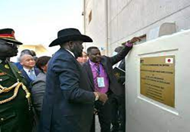
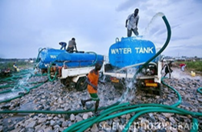

Slide 15
Key Updates on the Implementation of the Resilience Projects: January 2014 to October 2023:
PIA 1: Natural Resources and Environment Management
Volume of Fresh Water Harvested and Stored, and Groundwater Utilized in South Sudan:
INDICATORS | BASELINES 2013/2014 | ACHIEVEMENTS 2014/2019 | ACHIEVEMENTS 2019/2023 | CUMULATIVE TAREGETS 2022/2023 | CUMULATIVE ACHIEVEMENTS 2022/2023 | % PERFORMANCE
Increased volume of fresh water harvested and stored | 5,915,000 | 0 | 5,622,200 | 7,135,000 | 5,622,200 | 78.8
Proportion of groundwater utilized | 2,190,000 | 0 | 0 | 2,190,000 | 0 | 0

Slide 16
Key Updates on the Implementation of the Resilience Projects: January 2014 to October 2023:
PIA 1: Natural Resources and Environment Management
National Policies, Biodiversity, and Sustainable Forest Management
INDICATORS | BASELINES 2013/2014 | ACHIEVEMENTS 2014/2019 | ACHIEVEMENTS 2019/2023 | CUMULATIVE TAREGETS 2022/2023 | CUMULATIVE ACHIEVEMENTS 2022/2023 | % PERFORMANCE
No. of states domesticating National Policies on ecosystems services enhanced | 13 | 13 | 13 | 13 | 39 | 300%
Proportion of important cross-border biodiversity (land/river scapes) that are covered by protected areas | 410 | 410 | 410 | 83,954 | 1,230 | 1.5%
Area (ha) of land formally established as protected areas | 1,100 | 1,100 | 1,100 | 640,000 | 3300 | 0.5%
% Of forest area under sustainable forest management (hectares) | 190,429 | 190,429 | 190,429 | 640 ,000 | 471,281 | 73%

Slide 17
New Genus of Bat called Niumbaha superba discovered:
An international team of biologists led by Prof DeeAnn Reeder from Bucknell University, Pennsylvania, and Dr Adrian Garside from Fauna & Flora International had described a new genus of bat after discovering a rare specimen in Yambio, South Sudan in 2013 (Images below).
The discovery is significant because it highlights the biological importance of South Sudan and hints that this new nation has many natural wonders yet to be discovered.

Slide 18
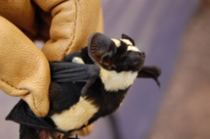
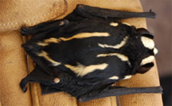
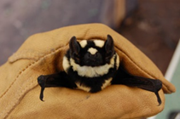

Slide 19
Updates on the Implementation of the Resilience Projects: January 2014 to October 2023:
PIA 2: Market Access, Trade and Financial Services:
Major Projects implemented with budget utilisation in USD
No. | Title of Project | Duration of the Project | Utilised Budget (USD)
1. | Juba-Terekeka-Rumbek Road | Mar 2019/ Mar 2022 (36 months) | 1.5 billion
2. | Juba-Bor Road | Sep 2019/ Sep 2022 (36 months) | 5.8 billion
3. | Bor-Malakal-Renk Road | Aug 2019/ Aug 2022 (36 months) | 7.8 billion
4. | Juba-Torit-Kapoeta-Nadapal Road | Jul 2019/ Jul 2022 (36 months) | 5.23 billion

Slide 20
Updates on the Implementation of the Resilience Projects: January 2014 to October 2023:
PIA 2: Market Access, Trade and Financial Services: Roads and Bridges Constructed)
INDICATORS | BASELINES 2013/2014 | ACHIEVEMENTS 2014/2019 | ACHIEVEMENTS 2019/2023 | TAREGETS 2022/2023 | % PERFORMANCE
Roads and Bridges tarmacked (Km) | 16,788 | 0 | 268 | 1,404.7 | 19.1
Roads paved and gravelled (Km) | 212 | 0 | 212 | 212 | 100

Slide 21
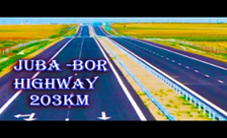
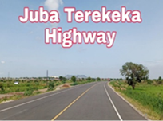
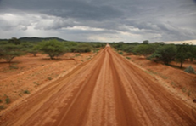

Slide 22
Challenges and Lessons Learnt during the Last Ten Years:
Challenges:
Political Instability and Incessant Conflicts
Low Investment in Agricultural Development
Inadequate Strategic and Coherent Policy and Institutional Framework for Disaster Management
Lack of Evidence-based Information for Decision Making on Drought Resilience
Inadequate Human Resources and Technical Capacity and Weak Institutional Arrangements and Capacities
Lack of a Dedicated Budget and Financing Strategy

Slide 23
Challenges and Lessons Learnt during the Last Ten Years:
Challenges:
Lack of Research/ Inadequate Extension and Denigration of Indigenous Knowledge Systems
Outbreak of COVID-19 Pandemic
Lessons Learnt:
The implementation of the Revitalized Agreement on the Resolution of the Conflict in the Republic of South Sudan (R-ACISS-2018), provides a conducive environment for the realization of a well-crafted South Sudan Vision 2040 that was designed as the plan for the new nation to address core development and state building agendas.

Slide 24
Challenges and Lessons Learnt during the Last Ten Years:
Lessons Learnt:
The platform coordination mechanism needs to have a wider participation of both development and humanitarian partners, to adjust for the fluid borders between development and humanitarian in the current South Sudan context.
National IDDRSI PCU staffing, equipping and facilitation is crucial for effectiveness, efficiency and out-standing performances and quality services delivery.
Proper coordination of monitoring, evaluation and learning mechanisms is key to tracking progress and delivery and sharing of information by key stakeholders.

Slide 25
Recommendations for the Implementation of IDDRSI from 2024 to 2027:
Partnerships are key in the resilience agenda, enabling vital changes not just in what is implemented but also, how it is implemented.
Development partners can align and relate to the national IDDRSI coordination structures and share information on drought resilience programming.
Member States should promote investments in the ASALs and Cross Border Areas in the region.

Slide 26
THAN YOU FOR YOUR ATTENTION

