Slide 1
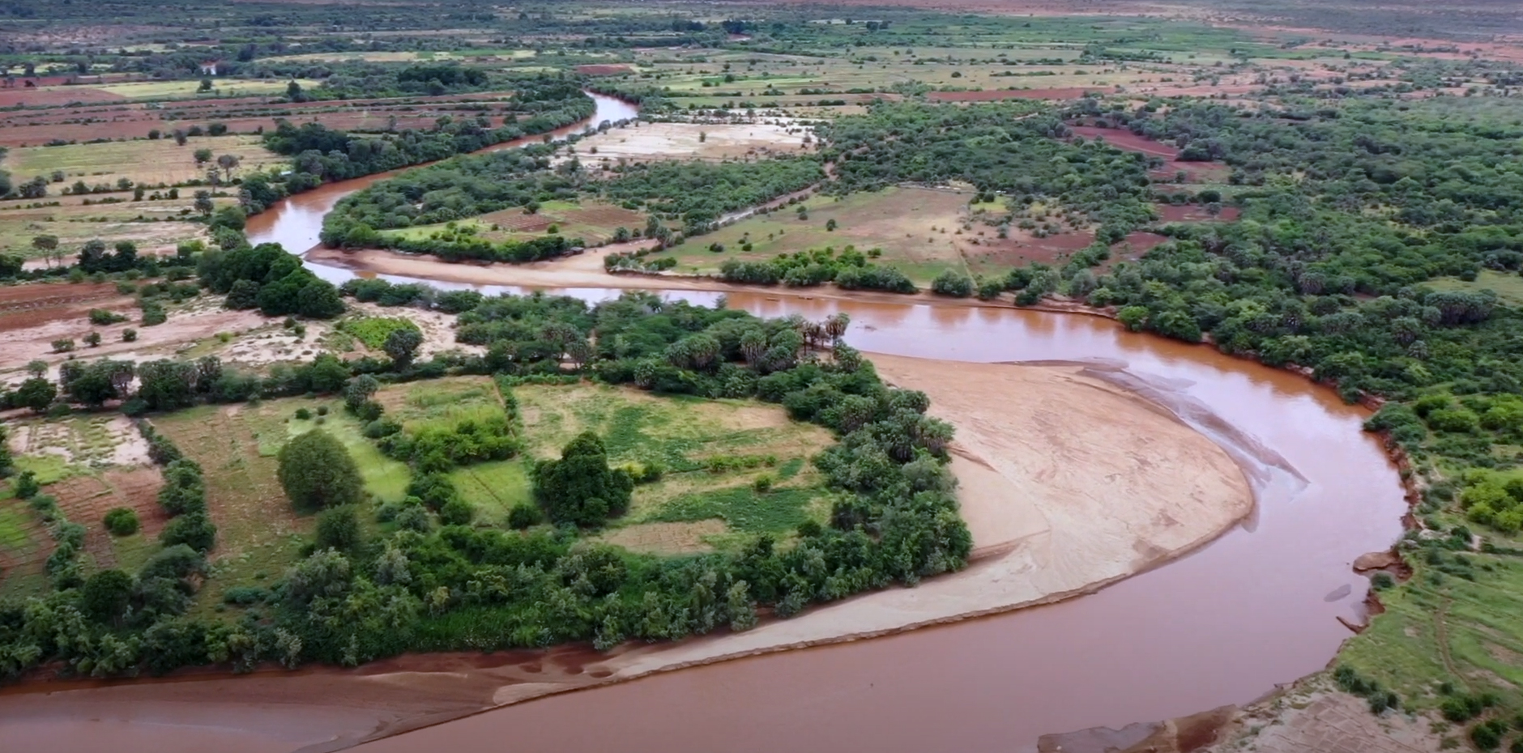
The Republic of Sudan
Sudan Progress Report
For
16th IDDRSI Platform Steering Committee Meeting
and 9th General Assembly
22-24 November 2023
Entebbe, Uganda
Samira Hassan Hamad
IDDRSI Focal point

Slide 2
Executive Summary
The report assesses the progress made in implementing the Sudan IGAD Drought Disaster Resilience and Sustainability Initiative (IDDRSI) in the context of the Country Programme Paper (CPP) since the previous Steering Committee Meetings of the Regional Platform.
In its interaction with IGAD activities, at regional level, Sudan reviewed the update of implementation of key recommendations for ten years including the last steering committee meeting.
The report also reviewed update of projects at national and state levels and the results achieved, challenges faced and lessons learnt. The recommendations also outlined.

Slide 3
Sudan developed and approved its CPP in 2013 (Phase I) and revised in 2019 approved in phase II.
The National and sub-national IDDRSI Platform composed of the high level institutions, ministerial high committee (10 ministries), the steering committee of 10 under secretaries and 10 high level directorates under and the National Expert Panel (NEP).
These institutions adopted and encouraged the process of mainstreaming the CPP elements in the national and sub-national planning and budget, to strengthen coordination for drought resilience and food security.
Support to IDDRSI coordination and Monitoring, Evaluation, Reporting and Learning mechanisms at national and sub-national levels, IGAD had conducted Monitoring, Evaluation and Learning Training Module for Sudan Country Programming Papers which was held in Khartoum.

Slide 4
The agricultural sectors are not able to face the huge crisis of food insecurity as a result of early drought and late heavy floods which have negative impact on production. Most of the projects are at small scale. Agricultural productivity is very low and production depends on horizontal expansion, affecting other production systems.
However, the IDDRSI implementation in Sudan during the ten years ago of CPP adopted for projects evaluation and programmes implementation it has been possible for Sudan to build successful institutional arrangements and to enhance efficient implementation of the IDDRSI across Sudan at the different levels.
These processes increased Sudan experience towards mainstreaming planning and budgeting of drought resilience with in the elements of the CPP as part of the national programme.

Slide 5
During the length of time associated with IDDRSI implementation, Sudan worked on projects and programmes to build successful institutional arrangements to enhance efficient implementation of the IDDRSI across Sudan at the different levels.
Implementation of projects and updating of activities towards achievement of the smart objectives increased Sudan experience towards planning and budgeting drought resilience as part of the national programme.
The successful interactions between Sudan as a member state and IGAD institutions and development partners. Many Projects are developed and financially supported by different partners.
Other projects sponsored by the development partners and government are in the pipe line to support resilience building and cross-border activities.

Slide 6
Blue Economy
Sudan contributed to the newly developed Blue Economy at regional IGAD at national level its targeted towards diversification of resilience and food security.
Sudan National Blue Economy was validated and approved.

Slide 7
Natural Resources Development and Environment Management enhanced (PIA 1)
Sustainable Natural Resources and Livelihoods Programme (SNRLP) the output is Promotion of the VDCs roles to enhance the development process at their respective villages in general with special emphasis on promoting the natural resources related activities which is linked with targeted beneficiary’s livelihood.
Percentage achieved is more than 81 % 639 villages are mobilized which are about 55,591 persons also the 58 networks were formed achievement percentage of more than 72 % also number of 639 VDCs re-formed achievement percentage of more than 81%.
Preparing Natural Resource and land-use Management Plans (NRLMPs) at villages and networks also achieved.

Slide 8
Drought Situation (PIA 1)
Drought and Floods
The water resources in Sudan constitute the most important factor as well as the main determinant of the agriculture expansion and the development of livestock resources.
The annual flood season is renewed in Sudan. The Ministry of Irrigation and Water Resources in Sudan - in a statement - called on "citizens in all sectors to take all necessary precautions and exercise caution" due to the high level of the Nile River.
Flood in Sudan At this time every year, warnings of Nile floods in Sudan are renewed, and the residents of the afflicted areas in the Nile River State (north) are experiencing great difficulties, amid fears of an escalation of the crisis. Residents of the flood-stricken areas in the River Nile State are facing great difficulty in obtaining drinking water and the basics of life.

Slide 9
Land Governance
The issuance of the land tenure policy revised on participatory approach would have a positive effect in reducing the ambiguous situation of land ownership and land use in Sudan.
At present, only 20% of the land registered under smallholdings for 80% of farmers while 80% of the agricultural land is under lease for 20% of farmers.
Land tenure problems created conflict between farmers and nomads because most of the nomadic routes reduced in with as large farms encroached into the corridors because of fragile land governance. The reporting period witnessed frequent incidents of conflicts between nomads and farmers through out Sudan.

Slide 10
Market Access, Trade and Financial Services (PIA 2)
Upgrading the Sudanese Sesame-seeds Value Chain to Meet SPS Measures and Facilitate Access to International Market is project lies in the results area (2.4) Strengthening Regional and Cross-Border Trade)
It was implemented to enhances the CPP indicator of rejections in export markets reduced to < 1 per year.

Slide 11
Projection IPC Acute Food Insecurity Situation in Sudan (PIA3)
Sudan’s macroeconomic situation is expected to continue to deteriorated this due to lack of a sustainable hard currency stream and increased need for food.
Import of essential food and non-food items will likely drive further currency depreciation and leads to increased risks. High prices, low purchasing power, intercommunal conflicts and seasonal floods will remain the key drivers of food insecurity.
In this contest, the mitigating factor is constituted by the main harvest happening in this period of analysis, expected to alleviate the compromised access to food and income driven by own production.

Slide 12
In Sudan, given climate extremes and insecurity, food availability is a crucial component of household food security status. small subsistence farmers, crop production in the North appears increasingly dependent on larger mechanized and irrigated farms.
Consequently, household crop production is more common in both 73 and 60 % of households Darfur reported farming compared with 40% in the past .
Decline in productivity presents significant impact on the effort of Sudan to build resilience and satisfy communities’ needs for food.

Slide 13
The Ministry of Animal Resources and Fisheries (MoARF) in cooperation with the Ministry of Agriculture and Forests (MoAF) and the Ministry of Irrigation and Water Resources (MoIWR) developed a programme for rehabilitation and conservation of range to build Resilience in response to Climate Change within the (Farming and Agro-pastoral) Systems in Sudan. Its ongoing program during the IDDRSI.
Rehabilitation, conservation and Management of range along pastoral corridors constitute programme components that aim to Build resilience and capacity of rangelands targeting nine States. The programme is in progress in nine targeted States.
The roles of research and extension systems in promoting resilient agriculture to bridge the current gaps in pastoral and agro-pastoral production systems.

Slide 14
Impacts of increasing Agricultural productivity with in the CPPs (PIAs)
Accordingly the outcome is reflected in compatibility of the integrated solutions with the components of the CPP in integrated approach. Looking at the CPP PIAs:
1. Natural Resources Development and Environment Management enhanced (PIA 1).
2. Market Access, Trade and Financial Services (PIA 2).
3. Enhanced production and Livelihood Diversification (PIA 3).
4. Disaster Risk Management(PIA 4).
5. Research, knowledge Management and Technology Transfer (PIA 5).
6. Peace Building Conflict Prevention and Resolution (PIA 6).
7. Coordination, Institutional Strengthening and Partnerships (PIA 7).
8. Human Capital, Gender and social Development (PIA 8).

Slide 15
The Sudan Comprehensive Agricultural Census Project
Its considered main issue for enhances progress toward the CPPS of the implementations and improve applications of interventions with high score to promote the ability of Sudan, communities and households to manage change by maintaining or transforming living standards in the face of shocks or stresses without compromising their long-term prospects.
Early March 2023, the Prime extending the implementation period of the CAC to 2023-2025. Despite Sudan’s current challenging political situation and lack of funds, implementation of Comprehensive Agricultural Census (CAC) activities has continued jointly with Sudan’s 6th Population and Housing Census since 2020, although it has slowed down considerably.

Slide 16
The actual step in progress involved Preparatory phase: Collecting information and making the essential maps for inventorying agricultural holdings and estimating needs. Defining specifications for electrical and digitalized systems. Two key technical documents were drafted, namely the Edits Rules, and Dashboard Indicators.
IT activities implemented during period before the conflicts period, was mainly dedicated to the reviewing and improvement of technical instruments, translation of some technical instruments, drafting of the remaining technical instruments and capacity building for the two censuses team.

Slide 17
Building resilience in the face of climate change within traditional rain fed agricultural and pastoral systems
This involved Mainstreaming Livestock Monitoring tools for estimate the caring capacity and Feed Balance adopted Proper utilization of Tools to monitor the rangelands in traditional Rain Fed Agriculture and Pastoral Systems in Sudan.
Introduction of drought-resilient seed varieties of sorghum,millet,groundnut and wheat that have demonstrated greater yields in the face of climatic changes through village procurement systems.
Introduce sustainable practices in agricultural production at the community level. This involves introduction of integrated women’s farms, home gardens, and demonstration plots.
Introduction of rangeland management practices that reduce pastoral stress on communal lands.

Slide 18
Update on the Implementation of Recommendations of 15th PSC
Rec. No | IDDRSI Recombination | Progress Achieved
 | IGAD Member States to remove barriers and strengthen trade between member states to facilitate the movement of foodstuff from the food surplus to deficit regions. | Sudan has many efforts to remove barriers and strengthen trade between member states to facilitate the movement of foodstuff from the food surplus to deficit regions. Plan of action for imported foodstuff (FSCMS) was discussed with FAO and the National Committee for imported Foodstuff control System was formulated.
 | Member States to step up their coordination efforts to cover projects implemented by various ministries and agencies to represent the status of resilience at the country level. Further urges the Member States to set up relevant stakeholder coordination mechanisms for proper planning, implementation, monitoring, evaluation and learning of resilience projects to improve resilience programming for optimum prioritization and synergy. | The MOAF had many of intera-institional committees that mainly functional to enhance the coordination mechanism among different stakeholders including resilience projects.
 | call upon all stakeholders to intensify investment in water development to ensure that communities in the ASALs have sustainable access to safe water through bringing “water to the people” approach that would also address their needs for water for livestock, crop and fruit production.

Slide 19
Update on the Implementation of Recommendations of 15th PSC
Rec. No | IDDRSI Recombination | Progress Achieved
 | Further urges the Member States to set up relevant stakeholder coordination mechanisms for proper planning, implementation, monitoring, evaluation and learning of resilience projects to improve resilience programming for optimum prioritization and synergy. | Sudan has many efforts to remove barriers and strengthen trade between member states to facilitate the movement of foodstuff from the food surplus to deficit regions. Plan of action for imported foodstuff (FSCMS) was discussed with FAO and the National Committee for imported Foodstuff control System was formulated.
 | The arid and semi-arid lands in the region are facing water scarcity for human beings, livestock and agriculture and recalling recommendation 14.4, call upon all stakeholders to intensify investment in water development to ensure that communities in the ASALs have sustainable access to safe water through bringing “water to the people” approach that would also address their needs for water for livestock, crop and fruit production | intensify investment in water development to ensure that communities in the ASALs have sustainable access to safe water through bringing “water to the people” many of the ministry of water resources and irrigation established to secure clean water for the fragile communities in rural areas.

Slide 20
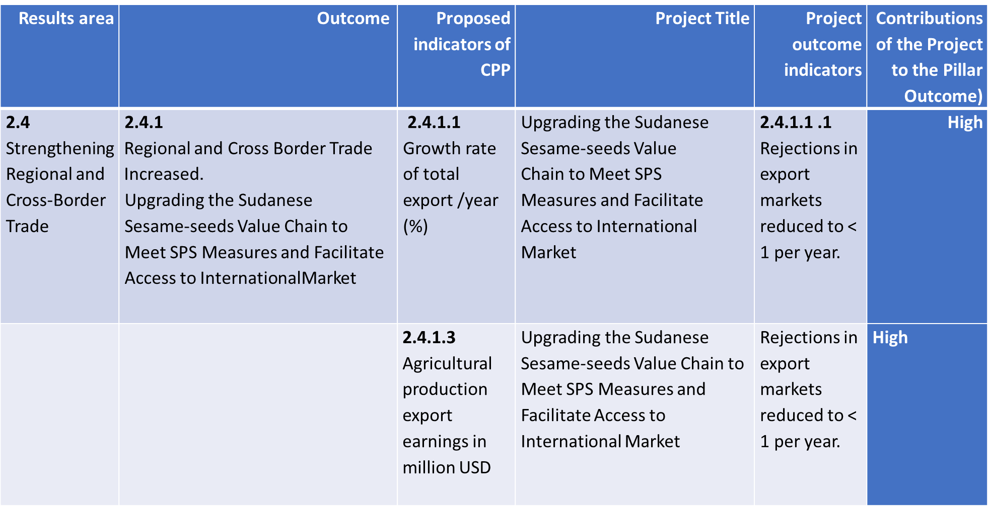

Slide 21
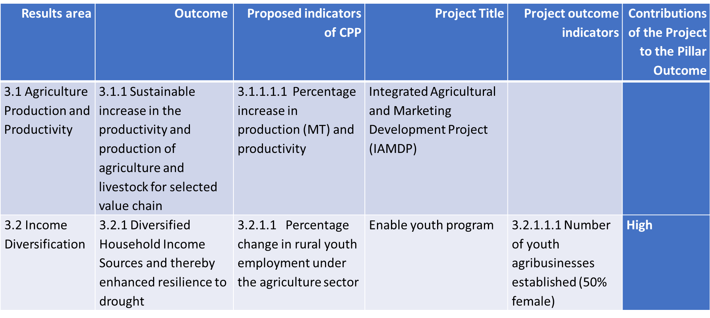

Slide 22
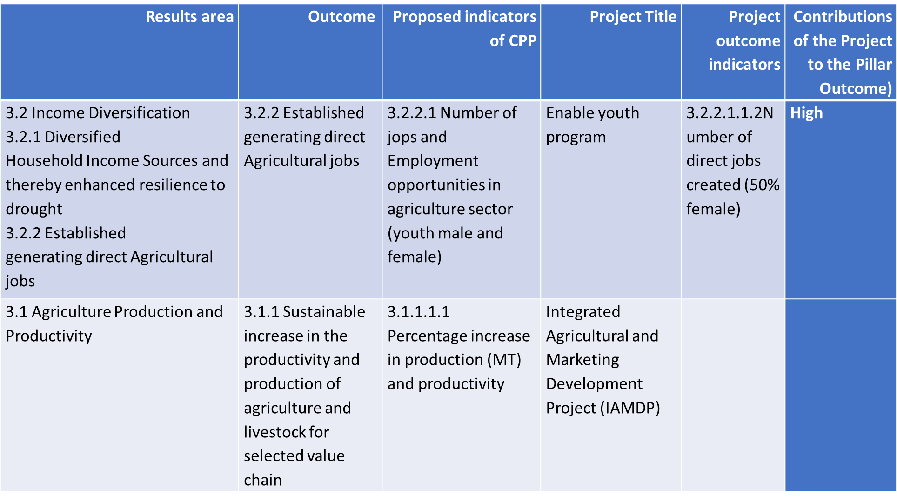

Slide 23
PIA8: Human Capital, Gender and Social development.
Enabling Youth Sudan program
Enabling Youth Sudan program funded by AfDB, implemented by ministry of Agricultural and forestry.
objective of the program is to create business opportunities and decent employment for young women and men along priority agricultural value chains in Sudan:
Component I.
I. Enabling Environment for Youth Employment in different aspects of Agribusiness.
2. Agribusiness ‘Awareness creation and promotion of agriculture as a business.
3. Creating a more conducive business environment for youth .
4. Agripreneurs; and Upgrading and equipping Youth Agribusiness Incubation Centers(YABICs)

Slide 24
Component II.
1. Entrepreneurship and Employment through Agribusiness
2. Incubation
3. Technical and business development training.
4. Business plans and loan applications.
5. Financing Emergent Businesses
Diversified Household Income Sources and thereby enhanced resilience to drought.
Number of youth agribusinesses established (50% female).
Component no.1 was achieved .
Its ongoing program in Sudan now stopped due to the political conflicts in Sudan.

Slide 25
Challenges & Constraints
1. Political instability and unrest presented difficult environment that restricted movement to implement the projects activities.
2. The ‘hold on’ of projects activities by the African Development Bank (AfDB), World Bank, and other development partners due to the current political situation of Sudan.
3. Unavailability of private sector service providers and the high cost of maintenance are the key reasons behind the slight delay in implementing the projects activities.
4. The difficulties in obtaining the local component for projects from the Ministry of Finance.
5. Lack of financial support from the government, NGOs, UN agencies and other international donors due to political situation in Sudan which need positive compliance from the donors for the country urgent needs

Slide 26
Recommendations
Approach donor partners to support development and application of the programme “integrated solutions” through projects and quarterly financial support of the programme.
• Establishment of farmer’s societies and cooperatives at village and locality levels,
• Financial support to farmers though credits and bank loans,
•Intensification of extension and technology transfer, through demonstrations, farmers schools and extension campaigns.
• Increasing centers for production of improved and certified seeds, Annual programme for distribution of improved seeds to small holders farmers,
Enhancement & financial support for the National Committee for imported Foodstuff control capacities to facilitate its jobs and responsibilities.
Implementation of IDDRSI did not cover some of the priorities intervention areas adequately.
Lack, inconsistencies, contradictions, overlap and conflict of interest within and between existing information and data offered.

Slide 27
• Involvement of organizations to contribute in financial and technical support.
• Enhance training to government technical staff in extension and M&E.
• Enhance regional involvement through IGAD.
• Adopt environmental classification to facilitate correct application of technical package like using Sorghum variety "in areas of rainfall ≥400 mm, and Arfaa Gadamic in areas with rainfall ≤400 mm.
Mainstreaming of tools to monitor the rangelands.
Provide fund from Government and IGAD.

Slide 28
Approach donor partners to support development and application of the programme “integrated solutions” through projects and quarterly financial support of the programme.
Establishment of farmer’s societies and cooperatives at village and locality levels.
Financial support to farmers though credits and bank loans.
Intensification of extension and technology transfer, through demonstrations, farmers schools and extension campaigns & Increasing centres for production of improved and certified seeds.

Slide 29
Annual programme for distribution of improved seeds to small holders farmers,
Involve organizations to contribute in financial and technical support,
Enhance training to government technical staff in extension and M&E.
Enhance regional involvement through IGAD.
Adopt environmental classification to facilitate correct application of technical package like using Sorghum variety "in areas of rainfall ≥400 mm, and Arfaa Gadamic in areas with rainfall ≤400 mm.

Slide 30
Lessons Learnt
Member States will not be able to successfully increase capacity and implement activities without interaction at regional level.
IDDRSI PIAs are rich and accommodate a wide range of resilience issues that contribute to resilience building, However, action plans can be revisited to facilitate the development of investment plans, including a better alignment with existing national plans and frameworks.
The adoption of operation planning enhance national coordination and strengthen the institutional arrangement.
IDDRSI projects indicators outcome well contributed to CPP Pillars. But they need to be more harmonized to the other countries based on the result outcome of projected.

Slide 31


