Slide 1
10th Anniversary
16th IDDRSI Platform Steering Committee Meeting and 9th General Assembly
Uganda’s Progress
22-24 November 2023
Entebbe, Uganda

Slide 2
Outline
Introduction
Progress of 15th PSC Recommendations
Progress of PIAs
4. Challenges
5. Lessons Learnt
6. Recommendations

Slide 3
1. Introduction
Uganda like the other member states is implementing its second 5-year Country’s Programming Paper, 2019 – 2024 whose focus is Consolidating the Path to Resilience and Sustainability.
It builds on the foundation laid in the 1st CPP and particularly in addressing the key constraints in managing drought emergencies.
The CPP contributes to the realization of Uganda Vision 2040 aspirations and it is also aligned to the Third National Development Plan whose goal is to increase household incomes and improve quality of life of Ugandans.
Presented herein is a summary of projects implemented during a 10 year journey towards improving livelihoods and enhancing resilience of communities to drought by transforming the agro-pastoralist and pastoralist sector into a more profitable, integrated and resilient economic system

Slide 4
A SNAPSHOT OF THE SITUATION IN UGANDA
TRADE
OPPORTUNITIES
Clear strategic direction and aspirations: Uganda V2040; NDPs; SDGs, AU Agenda 2063; AfCTA, CPP etc.
Low intra regional trade; low levels of economic integration.
PEACE AND SECURITY
FOOD AND NUTRITION SECURITY
Communal, intra and inter state conflicts are common
High levels of food insecurity and poor nutrition status.
POPULATION
ECONOMIC LANDSCAPE
45.5 million people, 80.3% are below 35 years of age . Low HDI category 0.52. Highest refugee hosting country (1.5 million)
Slow economic growth- 5-6%; high levels of poverty – 20.4; inequality despite reduction- 0.43, Single digit inflation rates -
ENDOWMENTS
WEATHER AND CLIMATE
Huge stocks of rivers, lakes, minerals, Tourism, Abundant Labor force, forest and wood products etc.
70% ASAL; drought prone; frequent climate induced disasters

Slide 5
2. Progress of 15th PSC Recommendations
SN | Recommendation | Progress
15.3 | Recognizing resilience as a multi-sectoral and multi-agency undertaking urges the Member States to step up their coordination efforts to cover projects implemented by various ministries and agencies to represent the status of resilience at the country level. Further urges the Member States to set up relevant stakeholder coordination mechanisms for proper planning, implementation, monitoring, evaluation and learning of resilience projects to improve resilience programming for optimum prioritisation and synergy | In Uganda, the Office of the Prime Minister (OPM) is mandated to coordinate all government programmes, policies and plans in the country. OPM annually develops the Government Annual Performance report that encompasses resilience initiatives implemented by government
15.5 | Noting that the arid and semi-arid lands in the region are facing water scarcity for human beings, livestock and agriculture and recalling recommendation 14.4, call upon all stakeholders to intensify investment in water development to ensure that communities in the ASALs have sustainable access to safe water through bringing “water to the people” approach that would also address their needs for water for livestock, crop and fruit production | During FY 2022/23, access to safe water in urban areas increased from 72.1% in FY2021/22 to 72.8%. The rate of investment in urban water supply infrastructure is lower than the rate of population growth rate in urban areas, estimated at 5% per year.
15.11 | Pursuant to the IGAD policy framework on informal cross-border trade aimed at boosting cross-border security governance, calls for the IGAD Member States to remove barriers and strengthen trade between member states to facilitate the movement of foodstuff from the food surplus to deficit regions. | According to the EAC Time Bound Program (TBP), there were 256 NTBs reported between 2004 and 2022, of which 234 were resolved. Over the last 7 years the rate of resolution has improved, increasing from 76%, from 2004 to 2015, to 94.9% in the years since then. The EAC Time Bound Programme reported that there were nine NTBs in 2015, and the average time of resolution was 535.3 days (about 1 and a half years) per NTB. In the years leading from this, the time to resolve NTBs improved, dropping from 328.4 days (about 11 months) in 2016, to 126.6 days in 2018. This illustrates a significant decrease in time taken to resolve an NTB. There was a slight increase in 2019 to 221.7 days as a result of COVID-19, however, the trend continues to fall, hitting 131.4 days in 2020 and 76.6 days in 2021.

Slide 6
3. Progress of PIAs
PIA 1: Natural Resources and Environment Management
Major Projects implemented with budget utilisation
No | Title of Project | Project Duration | Utilised Budget (UGX Billion)
1 | Water for Production Project | 7/1/2004 - 6/30/2017 | 712.00
2 | Water for Production Phase II | 7/1/2019- 6/30/2024 | 530.155
3 | Irrigation for Climate Resilience Project | 7/1/2020 - 6/30/2025 | 429,407
4 | Development of Solar Powered Irrigation and Water Supply Systems | 7/1/2020- 6/30/2025 | 476.730
5 | Farm Income Enhancement and Forestry Conservation Project II | 7/1/2016 – June 2021 | 400
6 | Drought Resilience Project in Karamoja Sub-region | 7/1/2019 - 6/30/2024 | 113.560
7 | Enhancing Resilience of Communities to Climate Change | 7/1/2017- 6/30/2022 | 31.920

Slide 7
3. Progress of PIAs
PIA 1: Natural Resources and Environment Management
Area under irrigation has increased from 14,418 hectares in FY2014/15 to 22,976 hectares in FY2022/23 against an irrigation potential estimated at 3.03 million hectares country wide.
The cumulative water for production storage capacity increased from 31.7 million cubic meters in FY2014/15 to 52.6 million cubic meters in FY2022/23 against a target of 57.52 million cubic meters in the same period.
Irrigation schemes constructed are: Ngenge (880ha), Rwengaaju (116ha), Tochi (500ha), Mubuku II (480ha), Doho II (1,000ha), Olweny (600ha) and Agoro (650ha) in the Districts of Kween, Kabarole, Oyam, Kasese, Butaleja, Lira and Lamwo respectively with a total of 4,226 hectares.

Slide 8
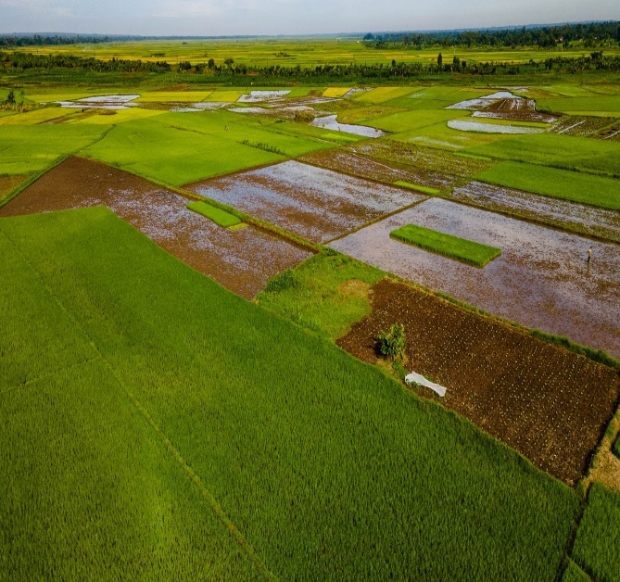
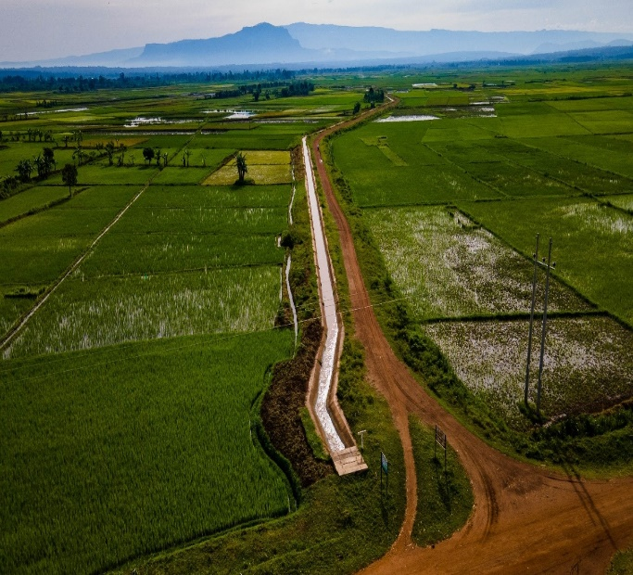
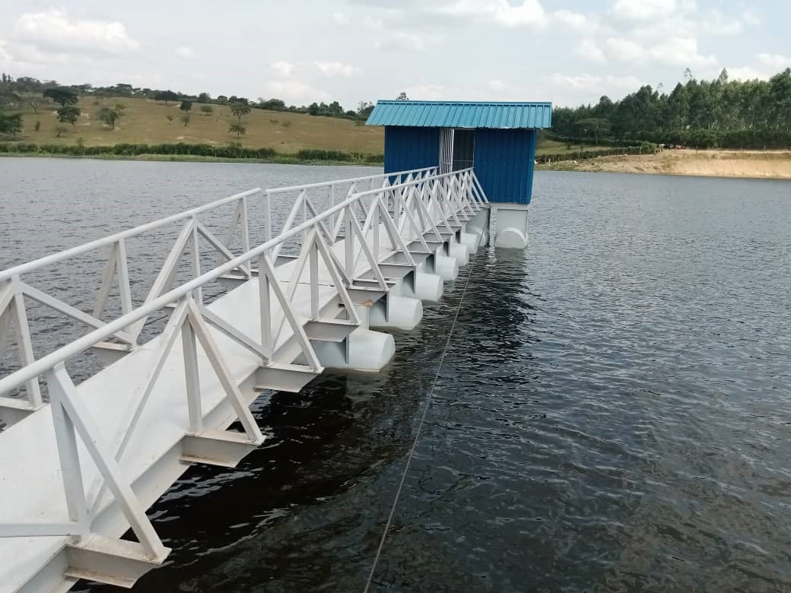
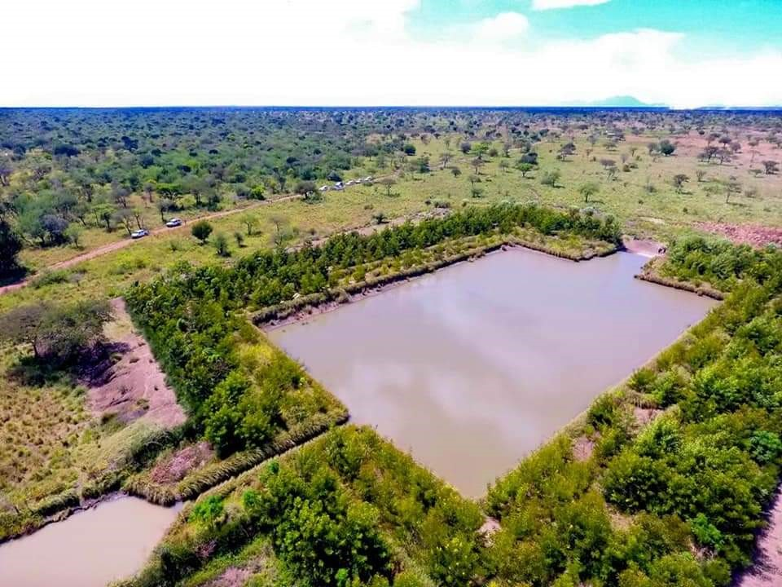
3. Progress of PIAs
PIA 1: Natural Resources and Environment Management
Water for Production (WfP) facilities constructed
Doho II Irrigation scheme in Butaleja District Tochi Irrigation scheme in Oyam District
Kyenshama earth dam in Mbarara District Loho Valley Tank in Kotido District

Slide 9
3. Progress of PIAs
PIA 2: Market Access, Trade and Financial Services
Major Projects implemented with budget utilisation
No | Title of Project | Project Duration | Utilised Budget (UGX) - Billion
1 | Regional Pastoral Livelihood Improvement Project | July 2015 - June 2021 | 120
2 | Markets and Agricultural Trade Improvements Programme (MATIP 2) | 7/1/2015 - 6/30/2022 | 320
RPLIP Project achievements. Construction of 12 markets, 12 slaughter sheds, 4 Quarantine stations (QS), 4 HG and 72 community crushes
MATIP2 Project achievements - Nine (9) Urban markets redeveloped, handed over and operationalized; Two (2) first and high levels value addition equipment installed in Arua and Busia; 16,951 vendors using market facilities (women) resettled in new Markets

Slide 10
3. Progress of PIAs
PIA 2: Market Access, Trade and Financial Services
Non-Tarif Barriers (NTBs) eliminated. Average Time taken to resolve NTBs improved, dropping from 328.4 days in 2016 to 76.6 days in 2021.
In most years more NTBs were resolved than reported thus indicating longer term NTBs being removed
Markets negotiated. These are: East African Community (EAC); Common Market for Eastern and Southern Africa (COMESA); African Continent Free Trade Area (ACFTA) including Specific Bilateral engagements such as Algeria, Serbia, Iran, Democratic Republic of the Congo (DRC) as strategy to expand market development and expansion opportunities aimed at achieving resilience and sustainability of the citizens of Uganda

Slide 11
3. Progress of PIAs
PIA 2: Market Access, Trade and Financial Services
Trade support facilities were constructed (warehouse, market & commercial buildings) over the period to to enhance compliance with product standards and SPS measures. Five have been constructed at Katuna, Mpondwe, Busia, Rwakhakha and Oraba
Access to Secure and Affordable Financial Services. Three hundred and seventy (370) SACCOs have been formed and strengthened compared to about seventeen (017) SACCOs in 2014 in the entire Kalamoja sub region. mainly accelerated by implementation of the Parish Development Model (PDM).
Regional and cross-border trade has increased over the years
Financial Year | 2013/14 | 2014/15 | 2015/16 | 2016/17 | 2017/18 | 2018/19
Exports | 907 | 1,035 | 959 | 1,063 | 1,271 | 1,165
Imports | 671 | 677 | 678 | 747 | 800 | 11
Merchandise Trade Balance | 236 | 358 | 281 | 316 | 471 | 1,154

Slide 12
3. Progress of PIAs
PIA 3: Enhance Production and Livelihood Diversification
Major Projects implemented with budget utilisation
No | Title of Project | Project Duration | Budget UGX – (Bns)
1 | Regional Pastoral Livelihood Improvement Project | July 2015 – June 2021 | 120
2 | Support to Sustainable Fisheries Development Project | July 2015 – June 2022 | 49.70

Slide 13
3. Progress of PIAs
PIA 3: Enhance Production and Livelihood Diversification
Bio-physical health of water bodies. To eliminate illegal fishing, the Government put in place the Fisheries Protection Unit (FPU). This resulted into significant increase in the fish volume up-to FY2018/2019.
Sharp decline of 20.6% of fish volumes realised in FY2019/20 to-date.
Reason. This was triggered by the reduction in the fish resource arising out of over fishing, smuggling, syndicated corruption and political interference

Slide 14
3. Progress of PIAs
PIA 4: Disaster Risk Management, Preparedness and Effective Response
Major Projects implemented with budget utilisation
No | Title of Project | Project duration | Budget UGX (Bn)
1 | Strengthening Community Resilience to Climate Change and Disaster Risk | July 2016 – June 2020 | 12.129
2 | Humanitarian Assistance | July 2016 – June 2023 | 18.972
3 | Resettlement of Landless Persons and Disaster Victims | July 2015– June 2023 | 30.00
4 | Support to Refugee Settlement | July 2014 – June 2021 | 0.915
District Contingency Planning. As of September 2023, a total of 47 districts have District Disaster Contingency Plans (DCP) and 15 out of the 47 developed their DCPs in the year 2023
Office of the Prime Minister has also developed a Preparedness and Contingency Plan for El Nino rains following the confirmation of El Nino conditions over the country in the rainfall period of September to December 2023

Slide 15
3. Progress of PIAs
PIA 4: Disaster Risk Management, Preparedness and Effective Response
The Health Sector also has Sector multi-hazard Contingency and preparedness Plans for various hazards which have potential to become public health emergencies, namely; cholera, malaria, anthrax, and yellow fever.
Disaster Risk Management Plan, 2022. Uganda developed a National Disaster Risk Management Plan, 2022, whose vision is “a disaster-resilient Uganda capable to anticipate, prepare for and coping with all disaster risks.
National Risk Atlas, 2021. In 2021, Uganda’s first National Risk Atlas was launched, and identifies seven priority hazards namely; drought, flood, landslides, lightning, hailstorm, windstorm and earthquake

Slide 16
3. Progress of PIAs
PIA 6: Peace Building, Conflict Prevention and Resolution
Major Projects implemented with budget utilisation
No | Title of Project | Duration of the Project | Utilised Budget (UGX) - Bns
1 | UPDF Peace Keeping Mission in Somalia (AMISOM) | 7/1/2015 - 6/30/2025 | 406.940
National Peace Building and Conflict Transformation policy developed. Ministry of Internal Affairs is working on a road map to undertake a Regulatory Impact Assessment & update the Policy as well as harmonize it with the already existing policies such as the National Transitional Justice Policy.
Peace Committees Established. Established & trained 5 district peace committees of; Abim, Napak, Napiripirit, Lwengo and Kapelebyong in Conflict Prevention and Management Resolution skills

Slide 17
3. Progress of PIAs
PIA 7: Institutional Strengthening, Coordination and Partnerships
Major Projects implemented with budget utilisation in USD
No | Title of Project | Project duration | Utilised Budget (USD)
1 | RIMA analysis in Uganda | 6 years | 2.6 million
2 | GCCA+ |  | 6 million
3 | Food security response project in Teso | 2022-2025 | 5 million
4 | Water for production and rural feeder roads projects |  | 12 million euros
5 | ProACT | 4 years | 8 million Euros
6 | Agriculture Climate Change Resilience Initiative | 3 years | 1.9 million
7 | Pastoral resilience and Livelihoods project | 5 years | 45 million

Slide 18
3. Progress of PIAs
PIA 7: Institutional Strengthening, Coordination and Partnerships
IDDRSI country platform was able to successfully establish two coordination platforms namely: i) National Expert Pannel (NEP); and the National IDDRSI Steering Committee to foster the IDDRSI agenda in Uganda
4 NEP meetings have been held in Uganda with major purpose of strengthening coordination and reporting on progress of the country towards achievement of IDDRSI objectives in various PIAs
NEP has also been able to coordinate and carry out joint monitoring and review of the resilience project implemented in the country. In particular, monitoring the outputs of the Regional Pastoral Livelihoods Resilience Project (RPLRP) in Eastern and Northern Uganda
Uganda has been able to train and establish 19 out of the 28 ASAL districts sub national coordination platforms for planning and budgeting and reporting using IDDRSI M&E frameworks
National steering committee. Established with membership from the 8 PIA implementing agencies is functional and holds bi-annual meetings to discuss progress of the country towards the achievement of IDDRSI objectives

Slide 19
3. Progress of PIAs
PIA 8: Human Capital, Gender and Social Development
Major Projects implemented with budget utilisation
No | Title of Project | Project duration | Budget (UGX)- Bns
1 | Global Fund for AIDS, TB and Malaria | July 2015 – June 2020 | 1,103.790
2 | Italian Support to HSSP and PRDP | July 2015 – June 2019 | 20.00
3 | Italian support to Health Sector Development Plan- Karamoja Infrastructure Development Project Phase II | July 2019 – June 2023 | 86.444
4 | Emergency Construction of Primary Schools Phase II | July 2015 – June 2020 | 3.736
5 | Youth Livelihood Programme (YLP | July 2013 – June 2018 | 265
6 | Youth Livelihood Project Phase II | July 2020 – June 2025 | 528.970
7 | Uganda Women Entrepreneurs Fund (UWEP) | July 2015 – June 2020 | 585
8 | Social Assistance Grants for Empowerment (SAGE) | July 2015 – June 2020 | 181.319

Slide 20
3. Progress of PIAs
PIA 8: Human Capital, Gender and Social Development
HC IIs upgraded in sub counties. To-date, a total of 381 HCIIs have been upgraded to HCIIIs under the projects of UgIFT (340) and URMCHIP (41) across the country. Of these, 270 are complete and functional. Works are ongoing on the rest and expected to be completed by June 2024.
Health Centre IIIs constructed in the 138 sub counties without any health facility. From FY2018/19 Government of Uganda with support from World Bank Project called Uganda Intergovernmental Fiscal transfer program started constructing HCIIIs in Sub Counties which did not have HCIIIs and upgrading some HCIIs to HCIIIs
In health, the UGIFT program has equipped, staffed, and upgraded 380 facilities to the health centre III (HCIII) level. At least 11,000 health workers have been hired for the least-staffed districts to enable them to meet minimum facility staffing levels.
Sixty-eight (68) twin staff houses built in Karamoja. Its only in Karamoja Region where the Karamoja Staff Housing project under Italian Government support to Uganda has built 68 twin staff houses in Kalenga, Kotido, Kaabong, Abim, Napak, Nakapiripirit, Amudat and Nabilatuk to reduce staff accommodation for health workers

Slide 21
3. Progress of PIAs
PIA 8: Human Capital, Gender and Social Development
Hospitals and Health Centre IVs. To increase health coverage in Uganda the following health facilities have been upgraded to Hospitals and HC IVs since FY2018/19. These are: Bondo HCIV in Arua, Bugaya HCIV in Buyende, Bujubuli HCIV in Kyegegwa, Kalaki HCIV in Kalaki, Kaserem HCIV in Kapchorwa, Kyangwali KCIV in Kikuube, Mpungu HCIV in Kanungu, Palabek Kal HCIV in Lamwo, Rugyeyo HCIV in Kanungu, Ruteete HCIV in Kabarole, Rwamanja HCIV in Kamwenge district, Muko HC IV to Hospital, Mitooma HC IV to General Hospital, Kalapata HC III to HC IV in Kabaramaido District.
Some of the hospitals that have been rehabilitated to improve health care services in the country are: Gombe Hospital in Butambala District, Koboko Hospital, Mukono Hospital, Luwero Hospital, Buwenge Hospital, Kotido Hospital and Kaberamaido Hospital.

Slide 22
4. Challenges
Absence of a law on Disaster Risk Management in Uganda. Despite presence of a National Policy for Disaster Preparedness and Management, the provisions of the Policy are not adequately implemented and cannot be enforced in absence of an enabling law. DRR interventions are implemented in an adhoc basis.
Limited availability and access to earth moving equipment for excavation of Communal and Individual Valley tanks. The available few equipment sets have aged and cannot serve the existing demand.
High demand for Water for Production Infrastructure and facilities which outstrips the planned investments
Land disputes in some of the areas where the water infrastructures planned could not be implemented, to some extent due to community resistance to construct WfP facilities while others demand exorbitant sums of money for land compensation and this consequently delays actual construction of the water infrastructure as planned

Slide 23
4. Challenges
Continued degradation of water catchments and the general environment, inadequate protection of lake shores, river banks and wetlands, and inadequate enforcement of water and environmental laws and regulations continue to be the main causes of flooding and destruction of property in the country
Insecurity in Karamoja Sub region. Heavy investment has been injected in the Karamoja sub region, however, implementation has been constrained by the insecurity
The limitations caused by the COVID-19 pandemic obstructed most of the planned interventions
Limited ownership of most of the interventions by state and non-state actors.
Limited ownership of most of the interventions by state and non-state actors

Slide 24
5. Recommendations
Take stock of the poor and the vulnerable. Develop a database of all the people in the Arid and semi-arid lands (ASAL) for better management of the beneficiaries from livelihood interventions
Develop and implement a strong Monitoring and Evaluation framework for interventions in the ASAL region
Develop Resource Mobilization Strategy
Continued sensitization and involvement of LGs beneficiaries. In particular, on their roles and responsibilities especially on the projects implemented in their areas.

Slide 25
5. Recommendations
Promote Risk identification through systematic hazard, risk and vulnerability mapping and review and update of such profiles to ensure the country is informed of all potential risk at all times.
Continue institutional support to NTB elimination
Continuously document success stories to inform the future and effective programme implementation

Slide 26
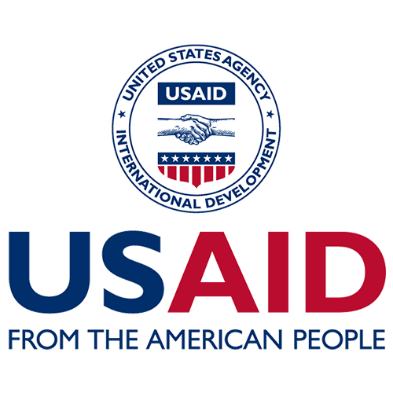
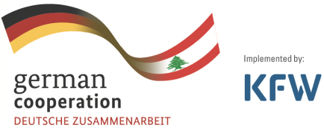

Slide 27
THANK YOU

